Slide 1
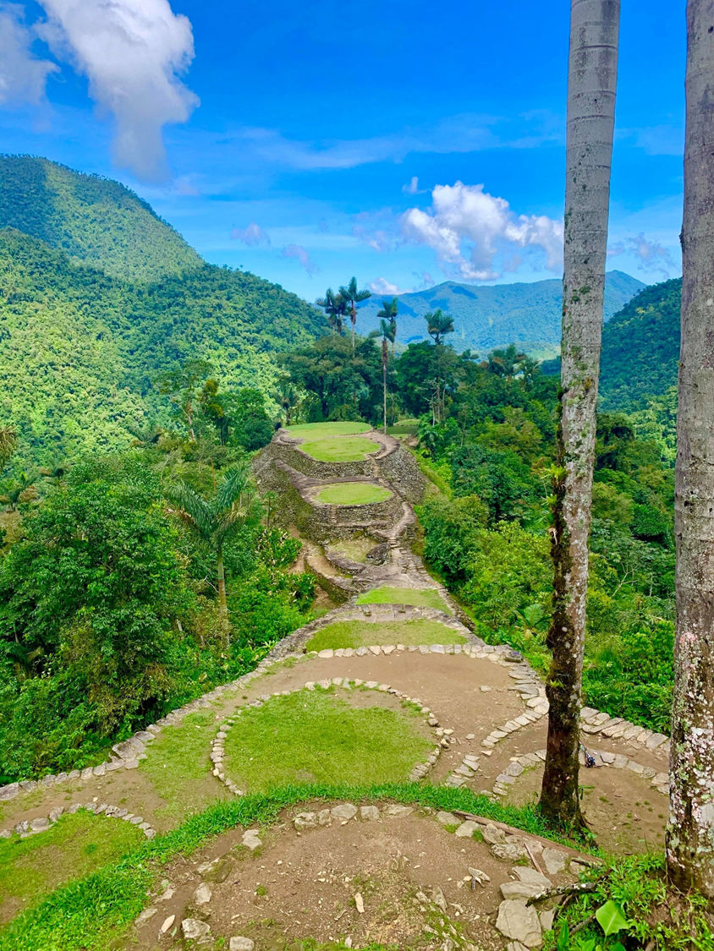
Stars Appeal Trek to the Lost City
20th to 29th April 2024

Slide 2
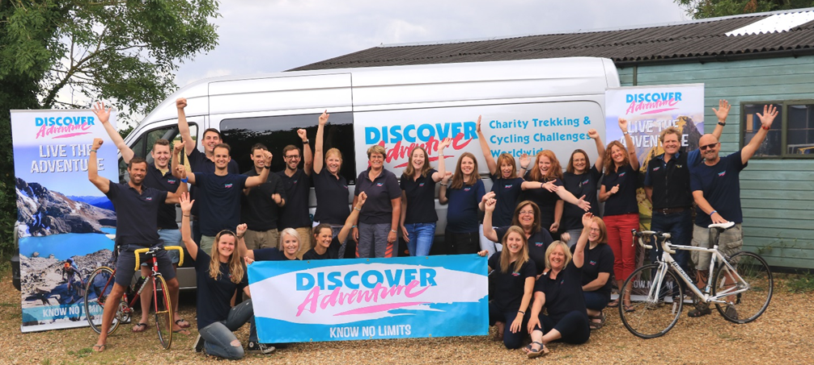
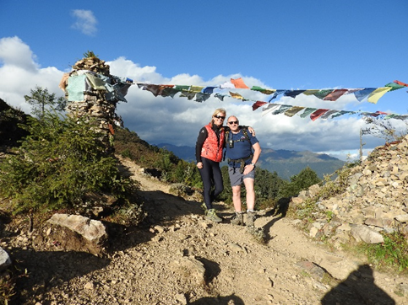
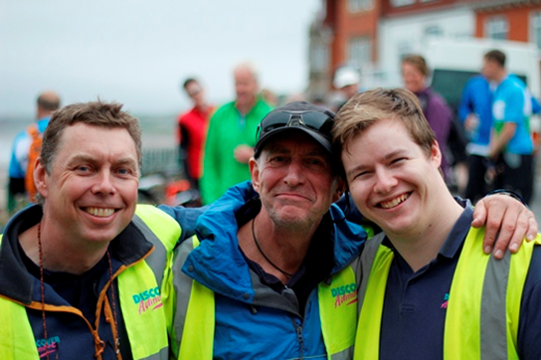
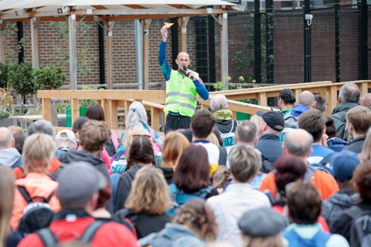
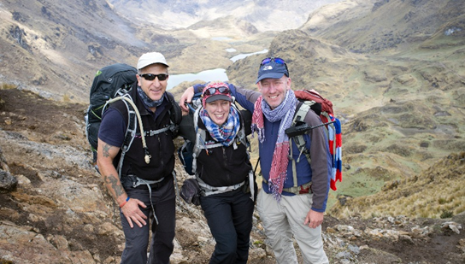
We are an adventure travel company with fundraising at our heart. Made up of people who love the outdoors, our mission is to create adventure challenges that enable people to achieve their ambitions - be that getting fit, pushing their boundaries or doing something incredible to change the lives of others through fundraising.
Est. 1994
Best Small Escorted Adventure Travel Company – as voted by our clients
£100+ million and counting… fundraised by our challengers!
58 trips, 4 continents

Slide 3
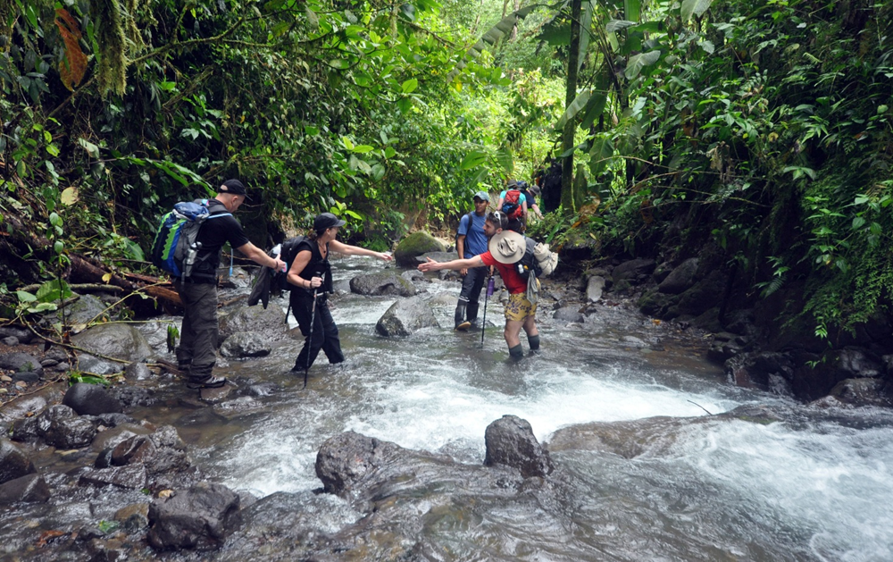
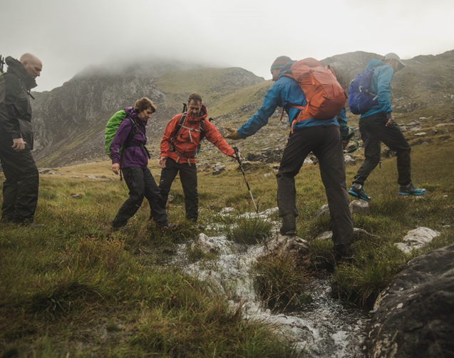
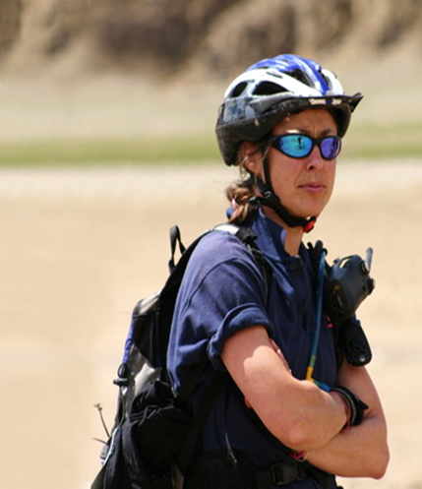
DA CHALLENGE CREW
Experienced DA leaders/medics – Employed to inspire and lead
DA leaders and crew are well known for their expertise, organisational skills and ability to inspire. Some are almost mini celebrities!
Supported by local crew on our overseas challenges
DA/local crew carry radios and satellite phone for safety
Full medical kit carried on challenges where medics are included

Slide 4
DA OFFICE CREW
Office crew are chosen for organisational skills, travel experience and passion for the industry they work in
Organise everything to do with our challenges from our office outside Salisbury
When you book a challenge you will have a dedicated challenge co-ordinator who will be in contact with you throughout the build up to the challenge

Slide 5
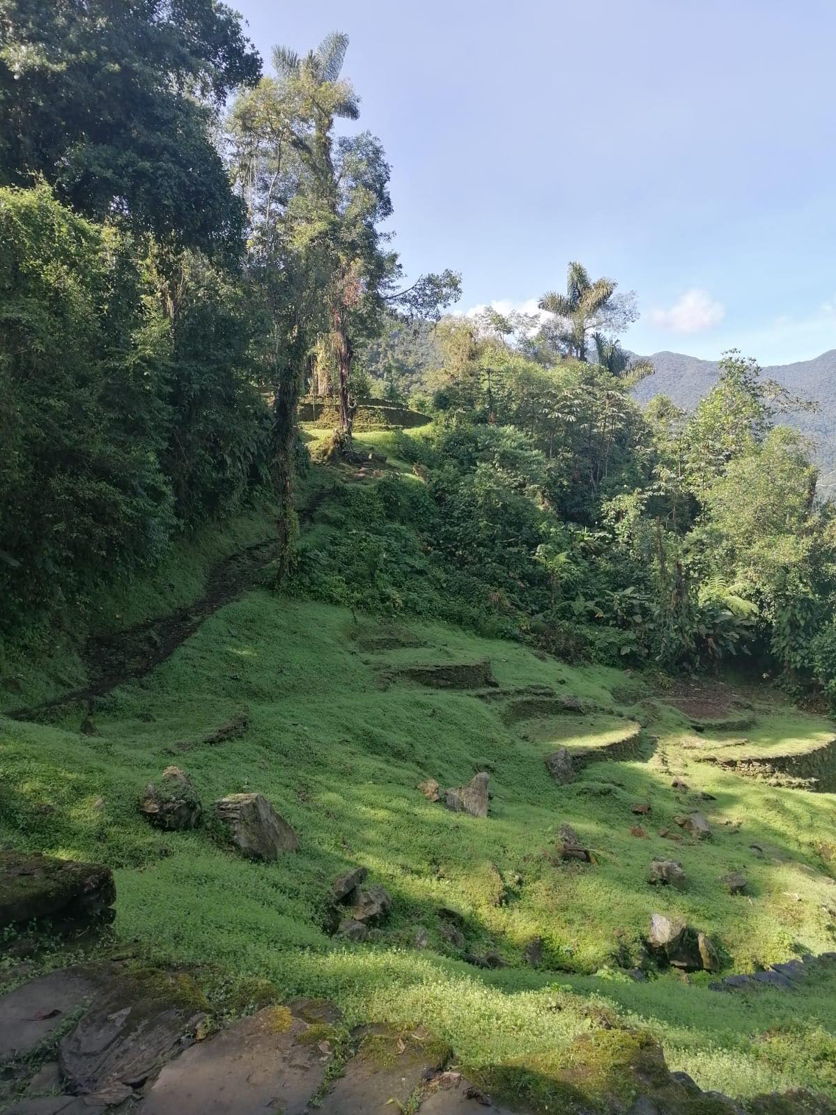
Trek to the Lost City
Grade – Orange 2
Duration – 10 days
Distance – Average of 6-7 hours of trekking per day
The Highlights
Natural beauty and cultural discovery
Untouched by tourism
Beautiful route through lush jungle and river valleys
Experience indigenous Kogui communities
Explore uncrowded ruins
What makes it challenging?
Steep Terrain and many steps
Long days
Sometimes overgrown and muddy trails
Humidity

Slide 6
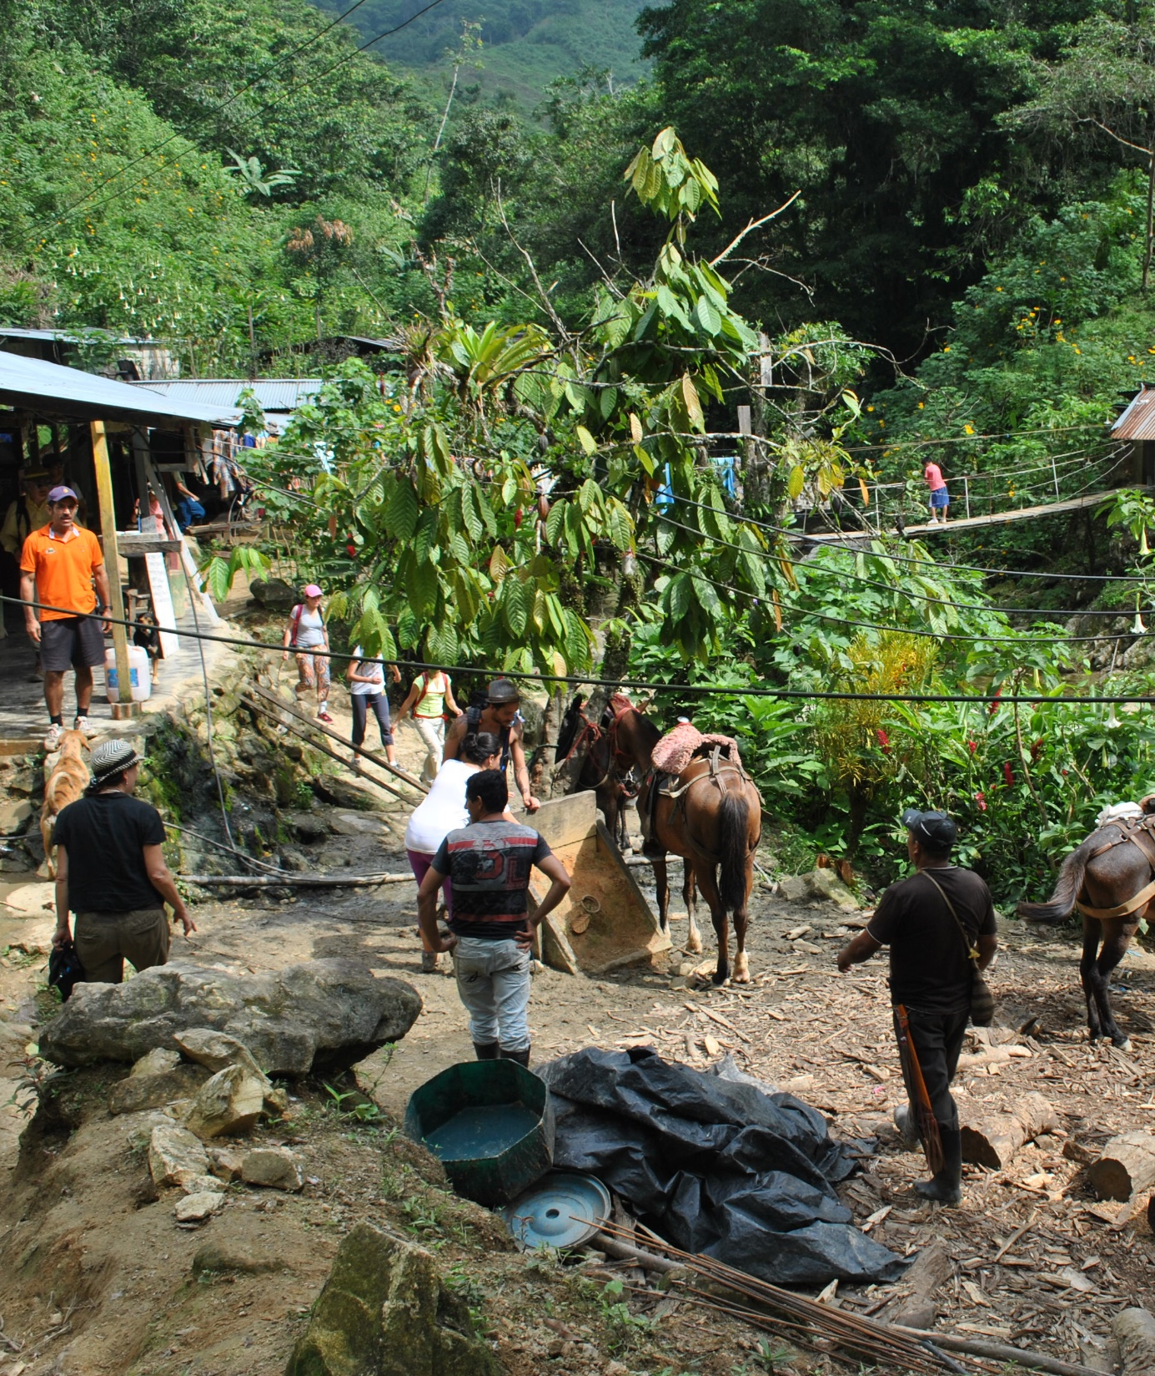
A TYPICAL DAY ON A DA TREKKING TRIP
06.30am – Wake Up
07.00am – Breakfast (bags packed)
08.00am – Briefing and depart
Warm up and stretches
Breaks, lunch together, and regroups throughout the day
19.00pm – Dinner together followed by evening briefing

Slide 7
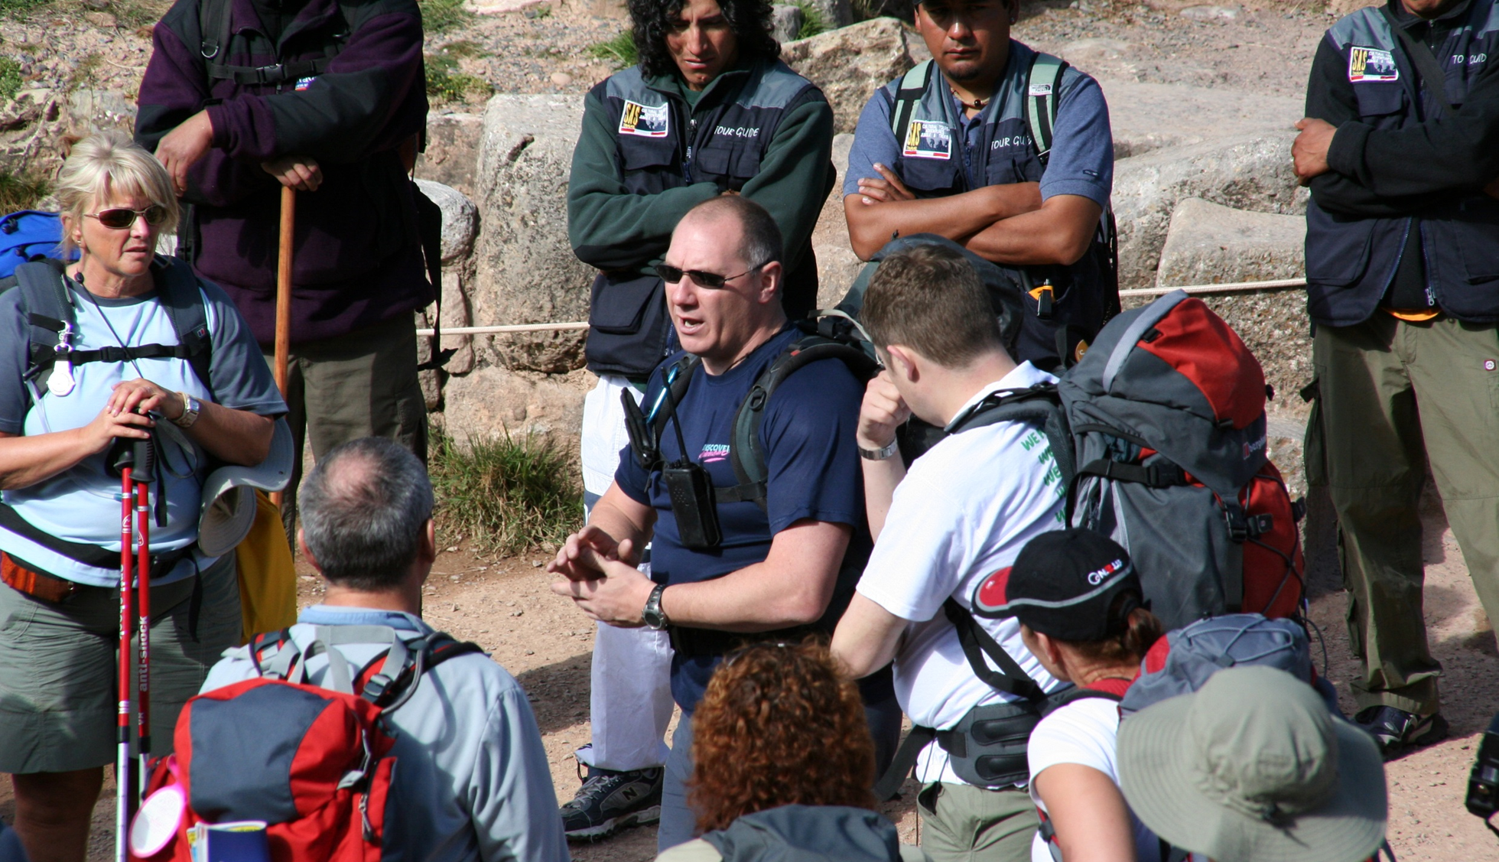

Slide 8
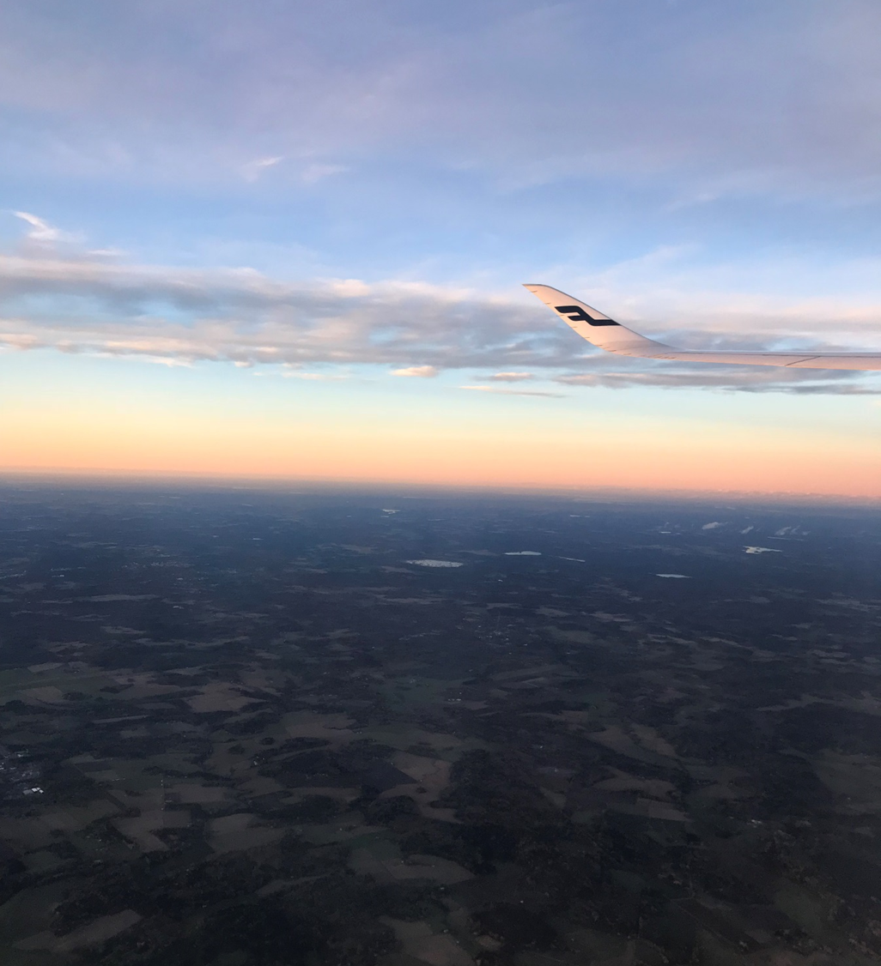
Day 1: Fly London to Bogata
Night: in flight

Slide 9
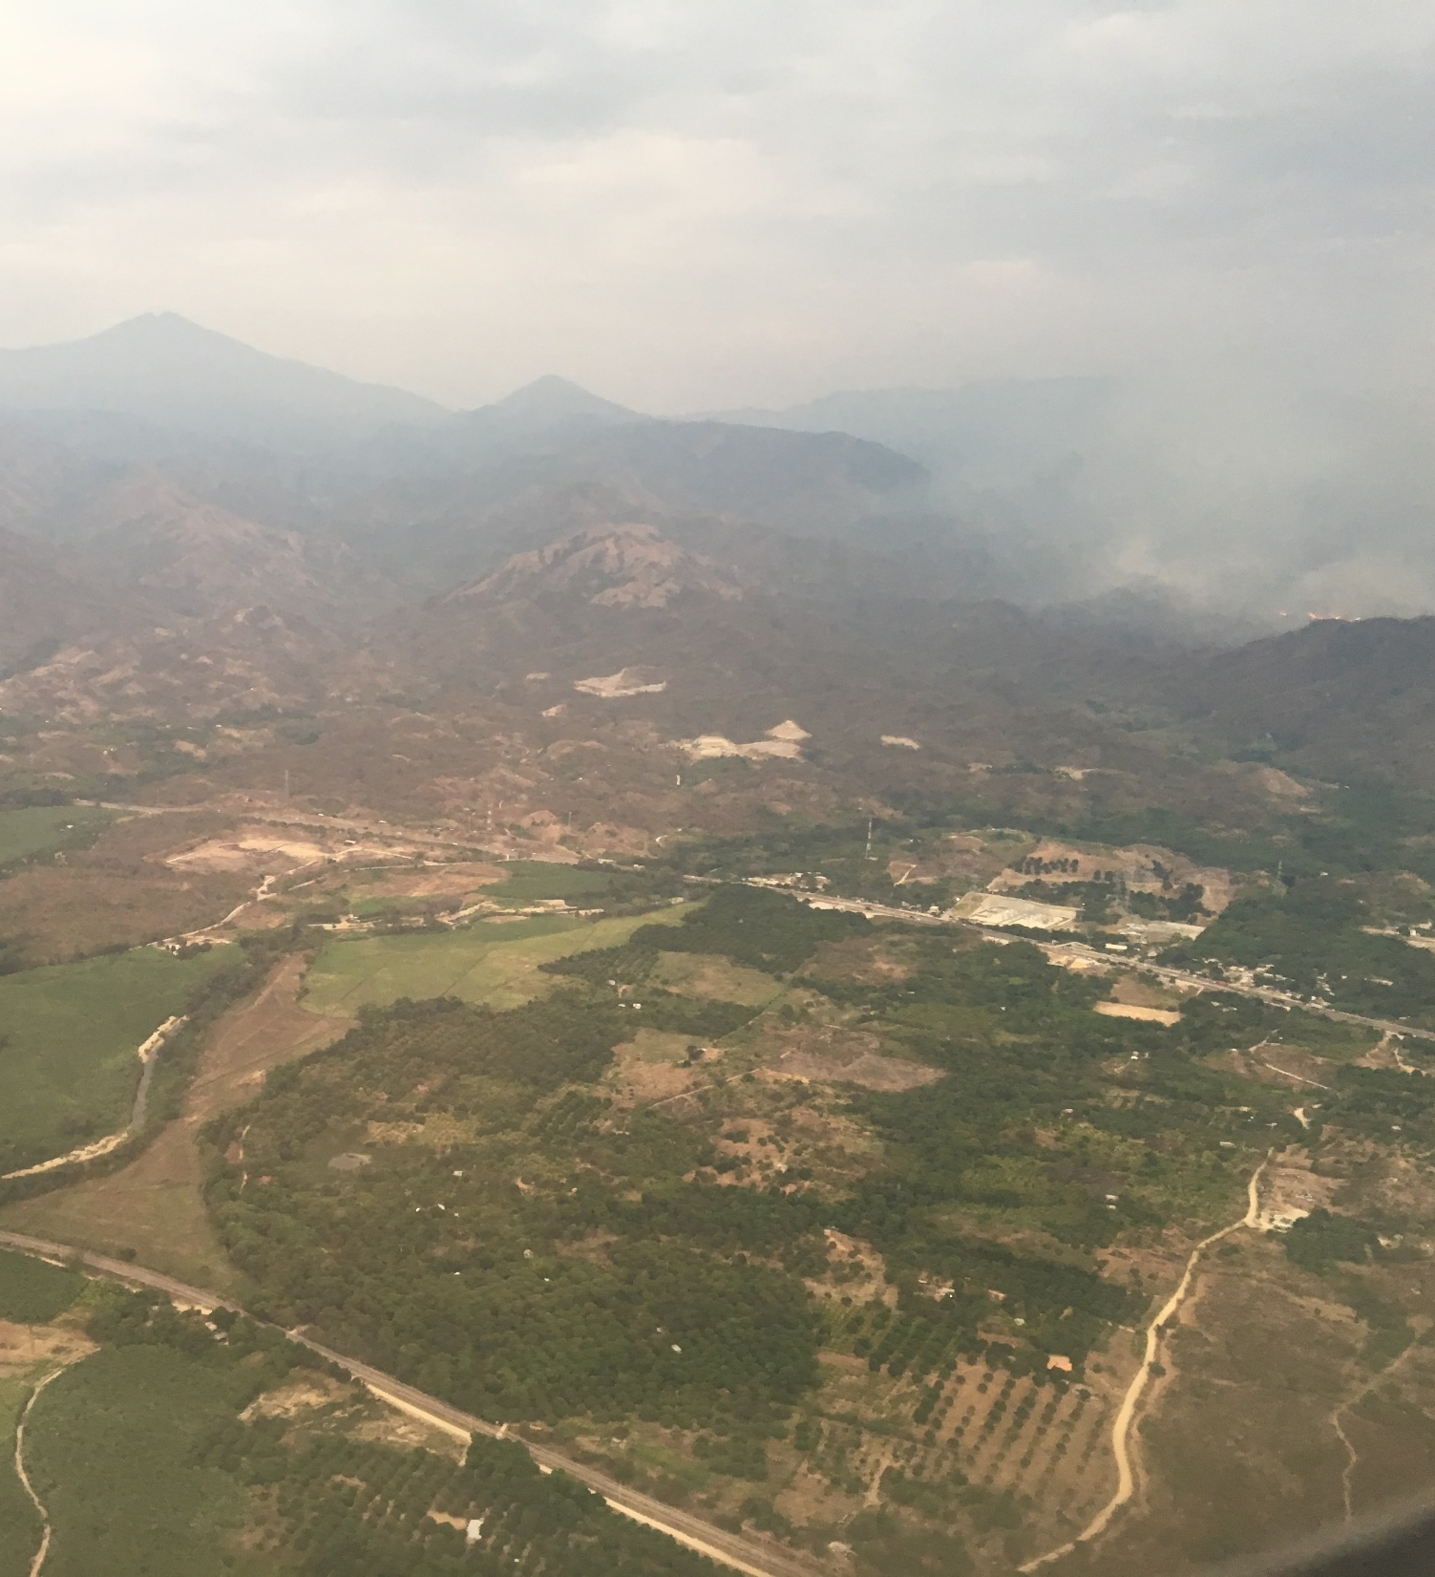
Day 2: Arrive Bogata and connect onto Santa Marta
Arrival in Santa Marta
City Tour
Transfer our hotel
Free time to explore the streets and wander the bay
Dinner and trip briefing
Night: hotel

Slide 10
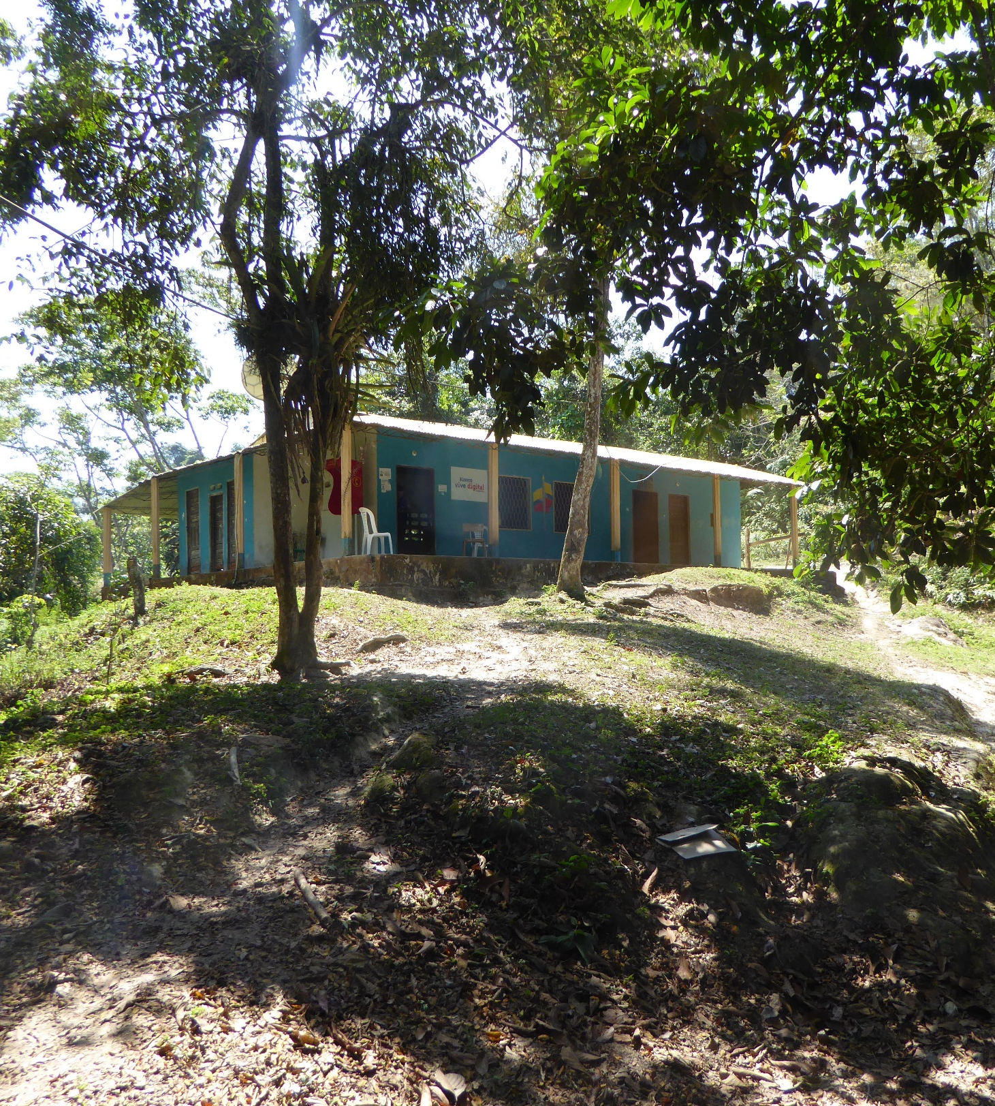
Day 3: Santa Marta – Casa Adan Camp
Early morning jeep ride from Santa Marta on roads and then dirt tracks to the small village of El Mamey for lunch.
We set off and the route eases us in fairly gently, and an early chance to cool off at a swimming hole.
A steep climb up through rainforest, which in the heat and humidity feels much further than it actually is, before descending into a lush
valley.
Night: camp

Slide 11
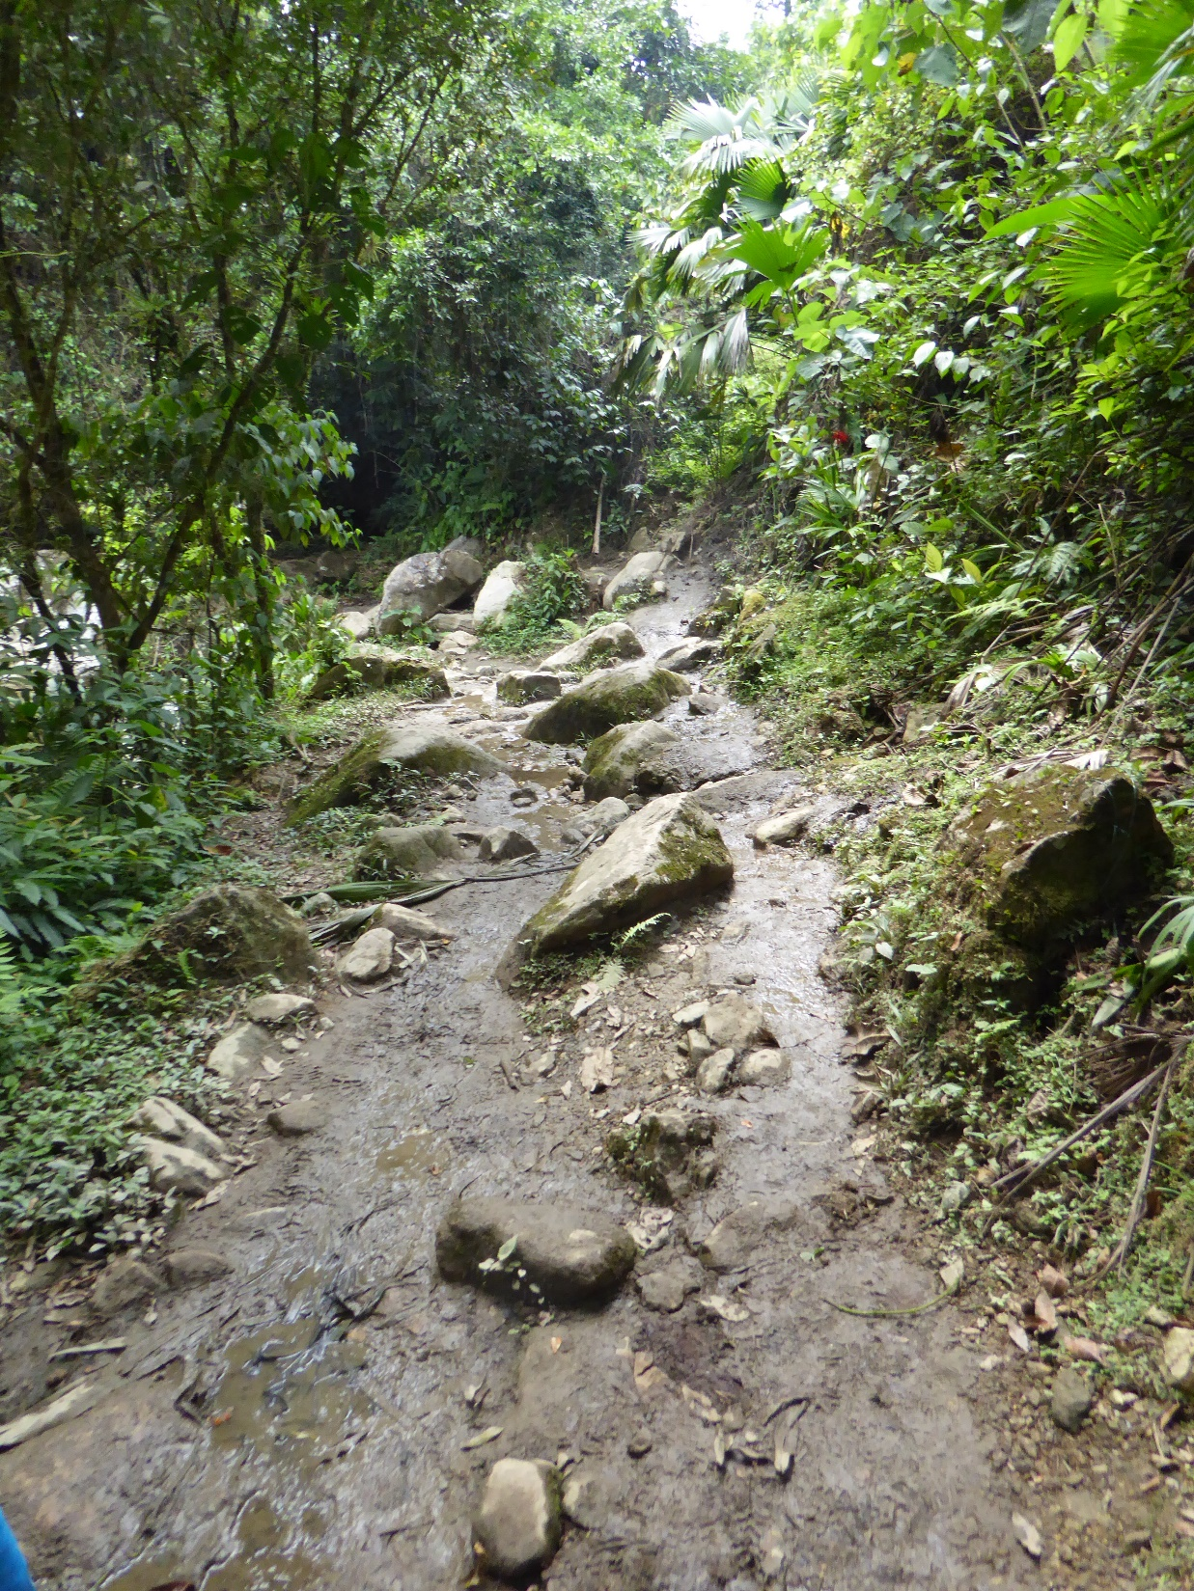
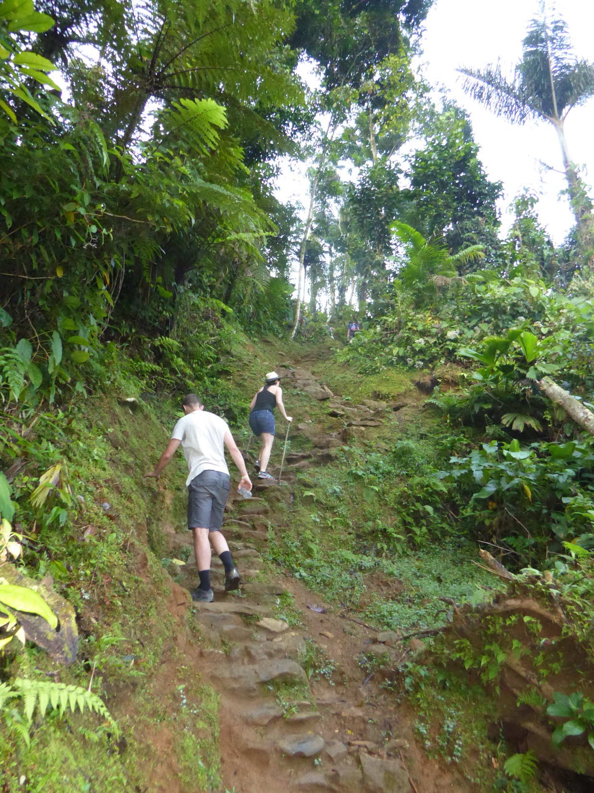

Slide 12
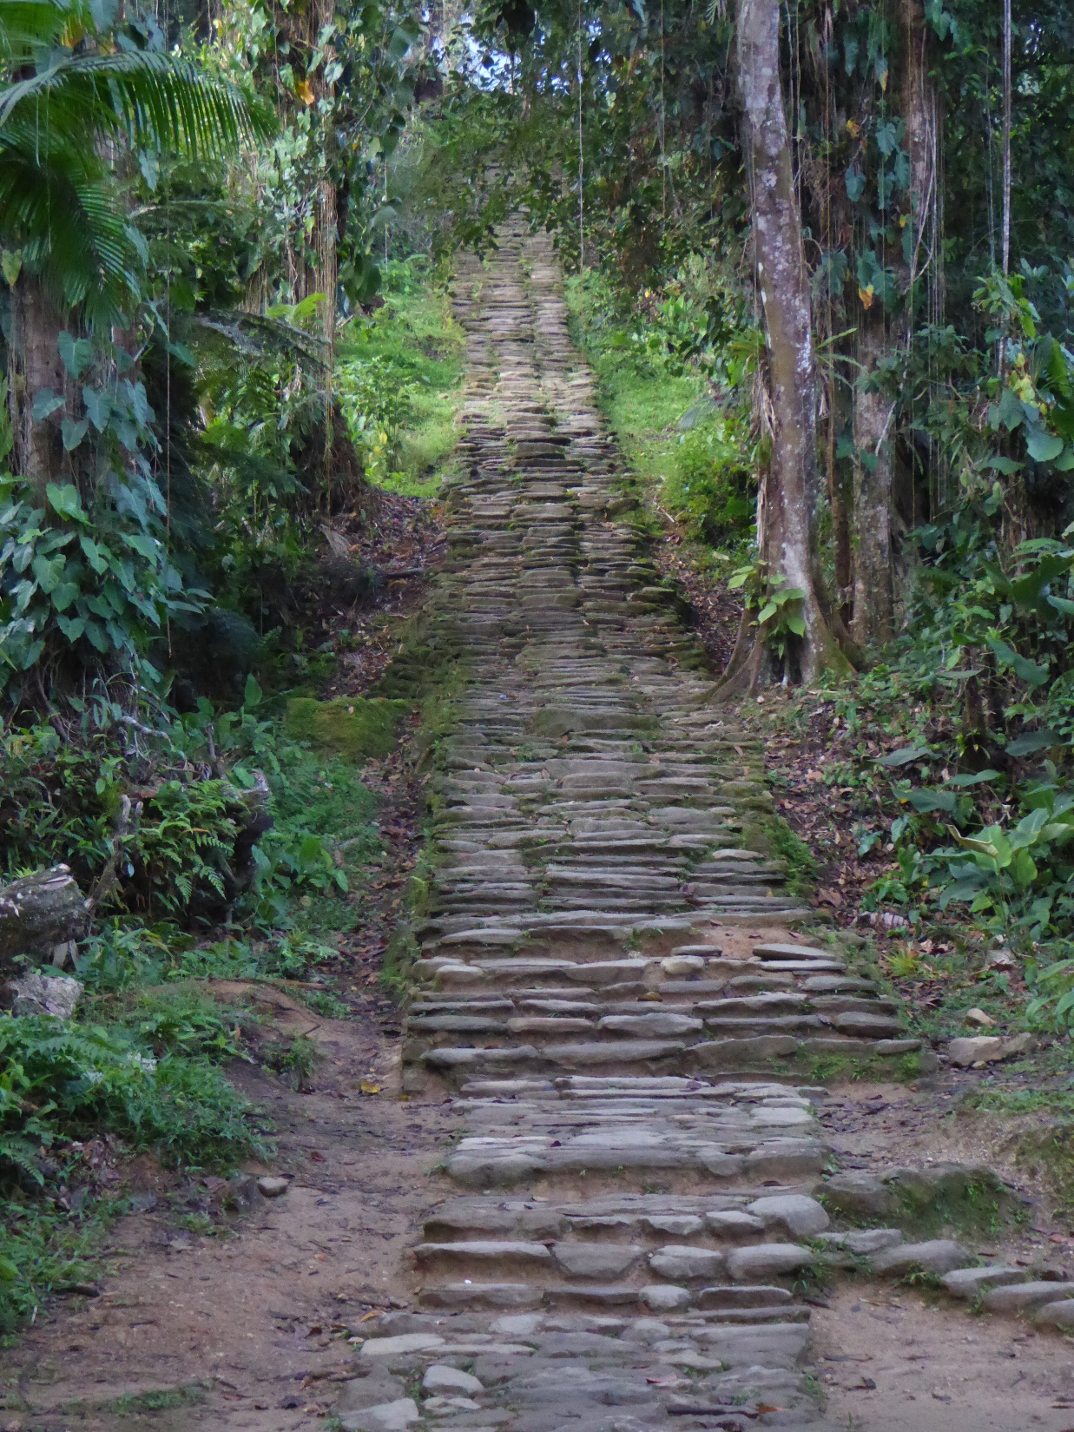
Day 4: Casa Adan Camp – Paraiso Teyuna Camp
After an early breakfast we trek steadily uphill through the heart of the jungle
The air is thick with birdsong and hum of insects and you may see toucans, parakeets and hummingbirds along with some of the many species of tiny frogs.
After regular stops for fresh fruit we reach the top of our ascent.
A long downhill through beautiful landscapes and Kogui villages to camp.
A long, tough day with a rewarding swim in the river at camp
Trek: approx. 9-11hours
Night: camp

Slide 13
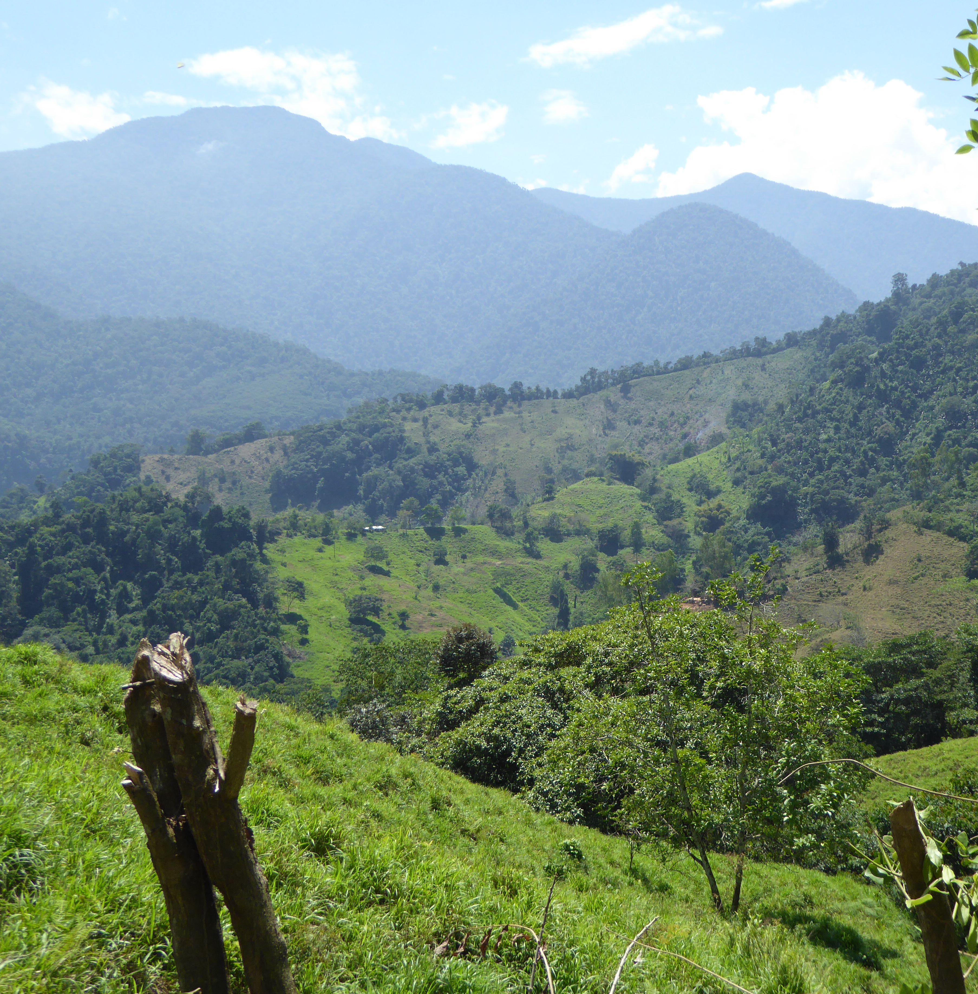
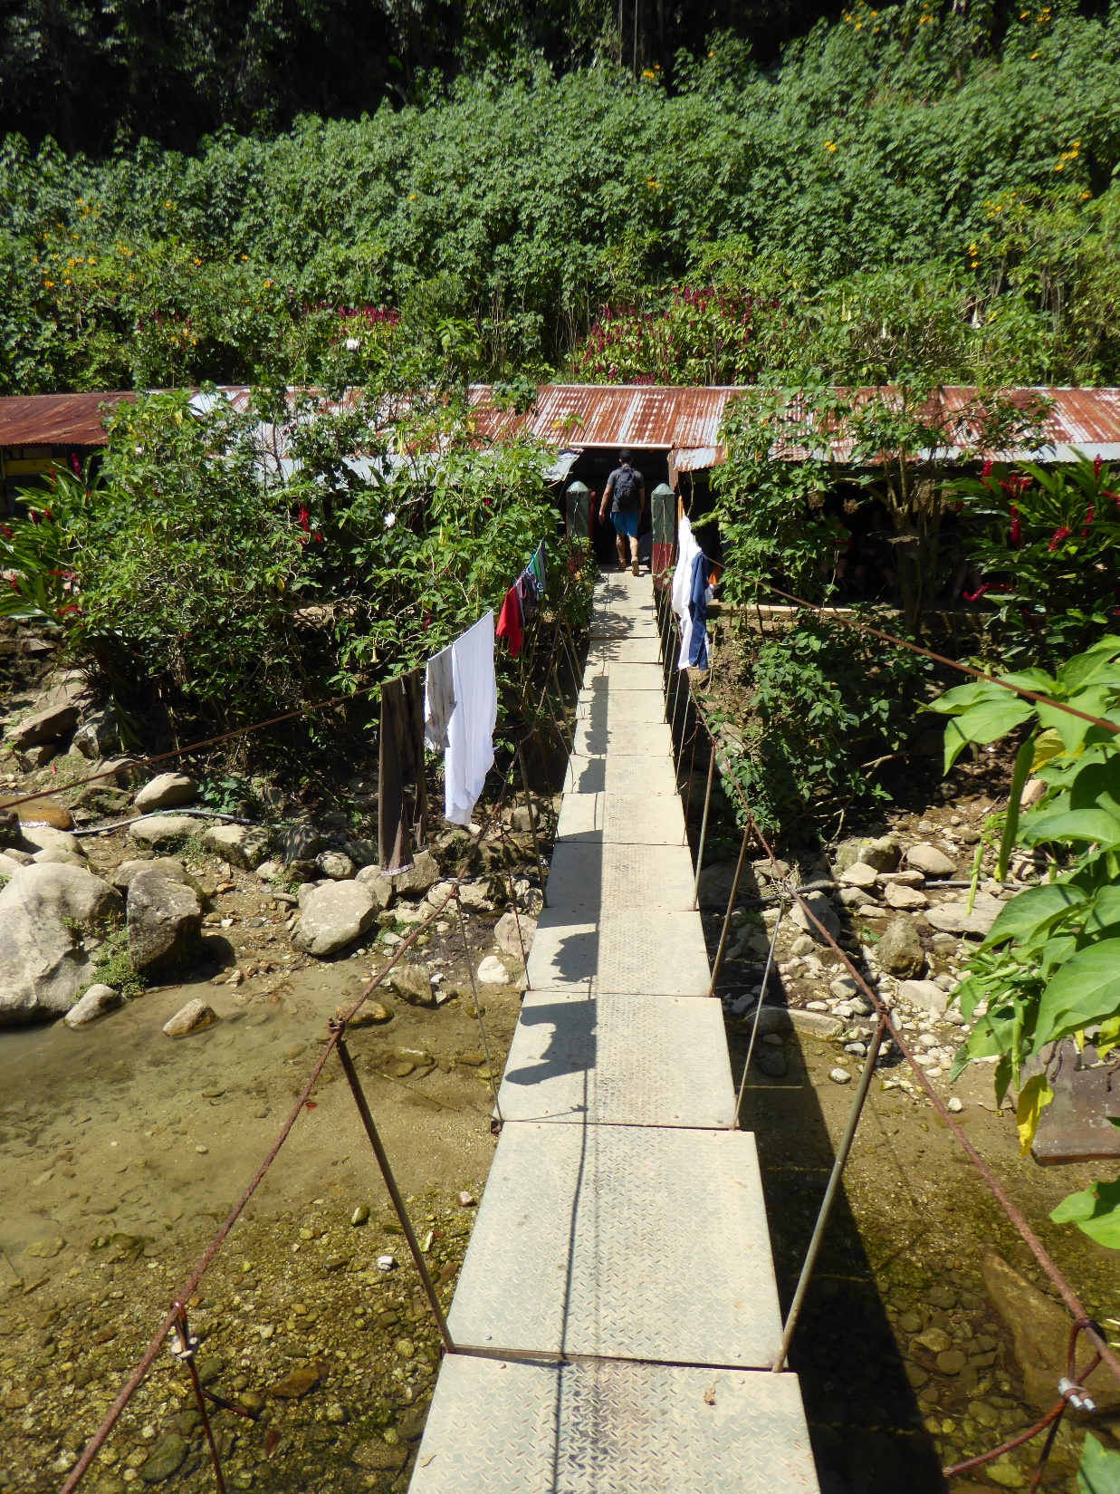

Slide 14
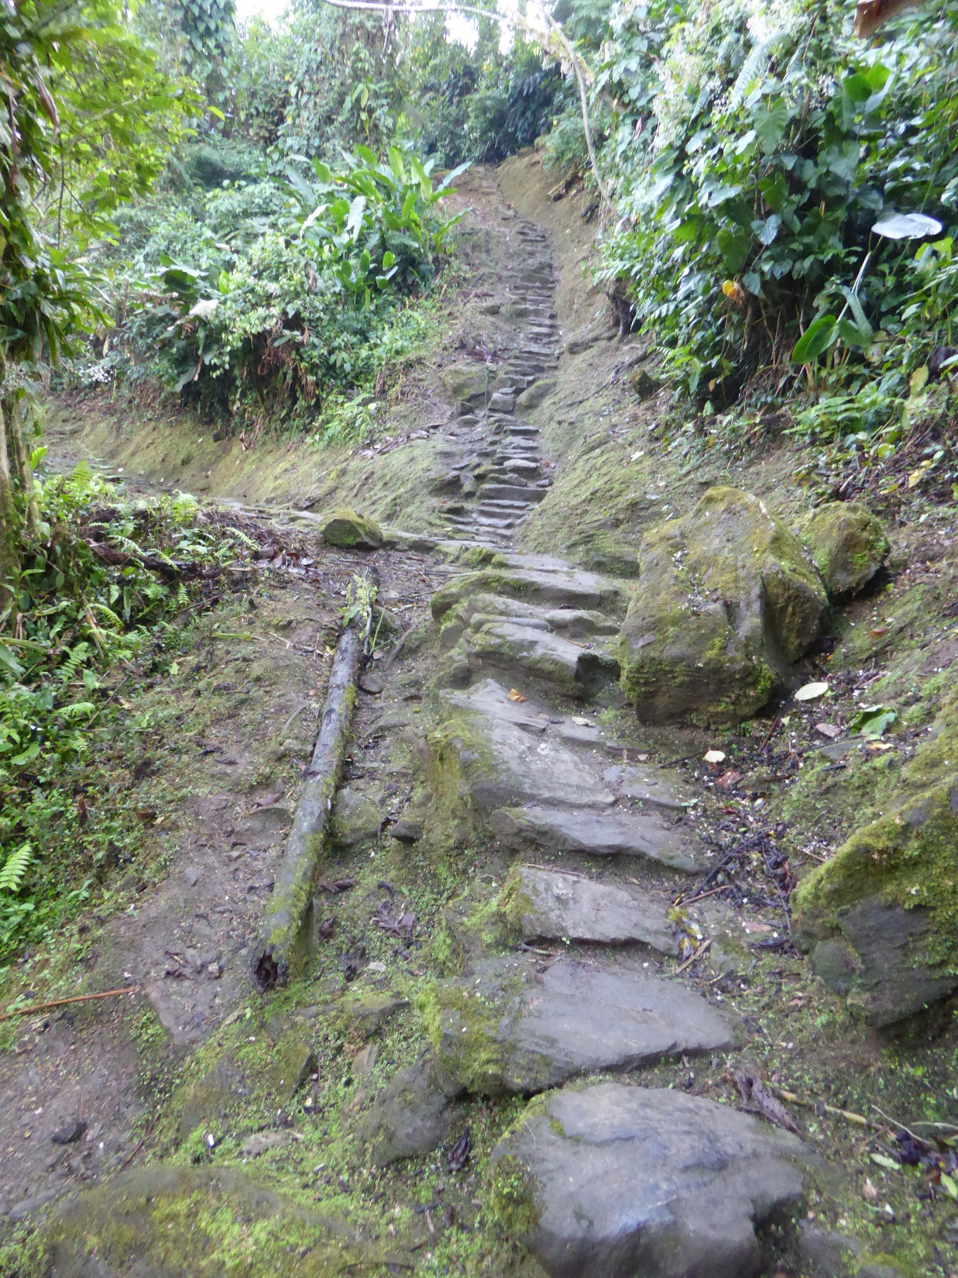
Day 5: Paraiso Teyuna Camp – Lost City – Wiwa Camp (or Mumake
We rise early for an exciting day exploring the Lost City.
The jungle path leads us alongside the river for a stretch, and we cross over to reach the ancient flight of 1200 stone steps rising through the dense vegetation to the ruins of the sacred city.
A tour allows us to appreciate its history and significance.
After soaking up the views and unique atmosphere we return back along the trail via last night’s camp, and further on to Wiwa.
Trek: 10-12 hours (incl. 3 hours at Lost City)
Night: camp

Slide 15
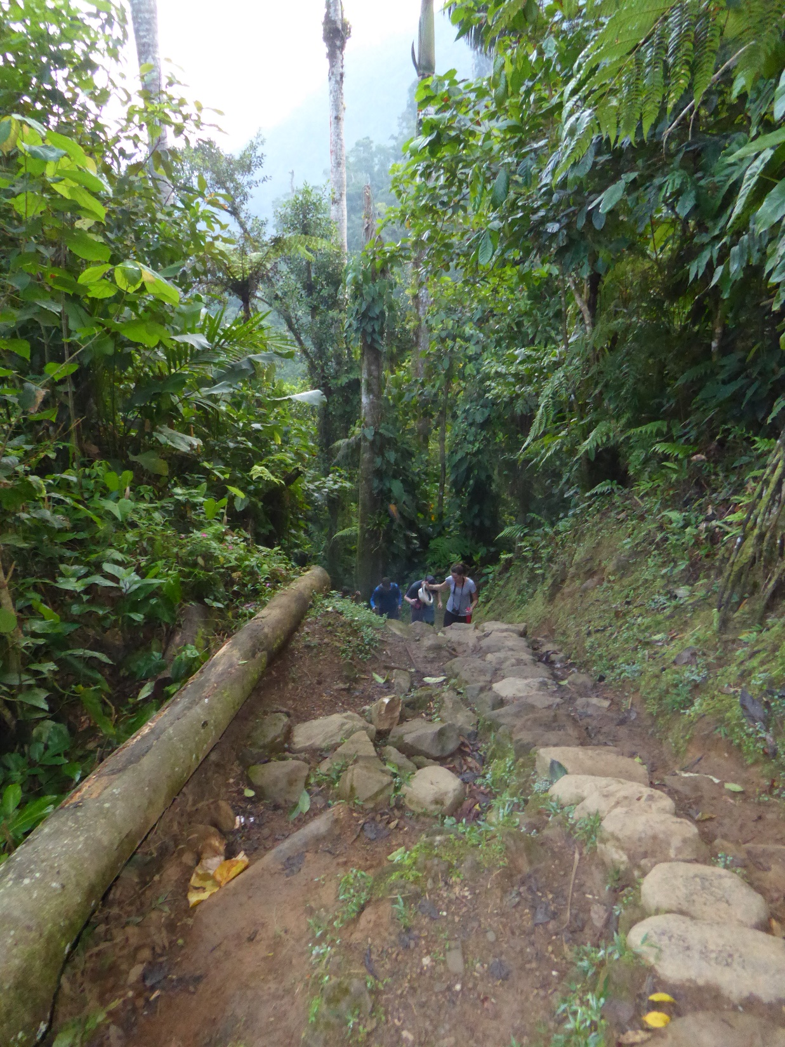
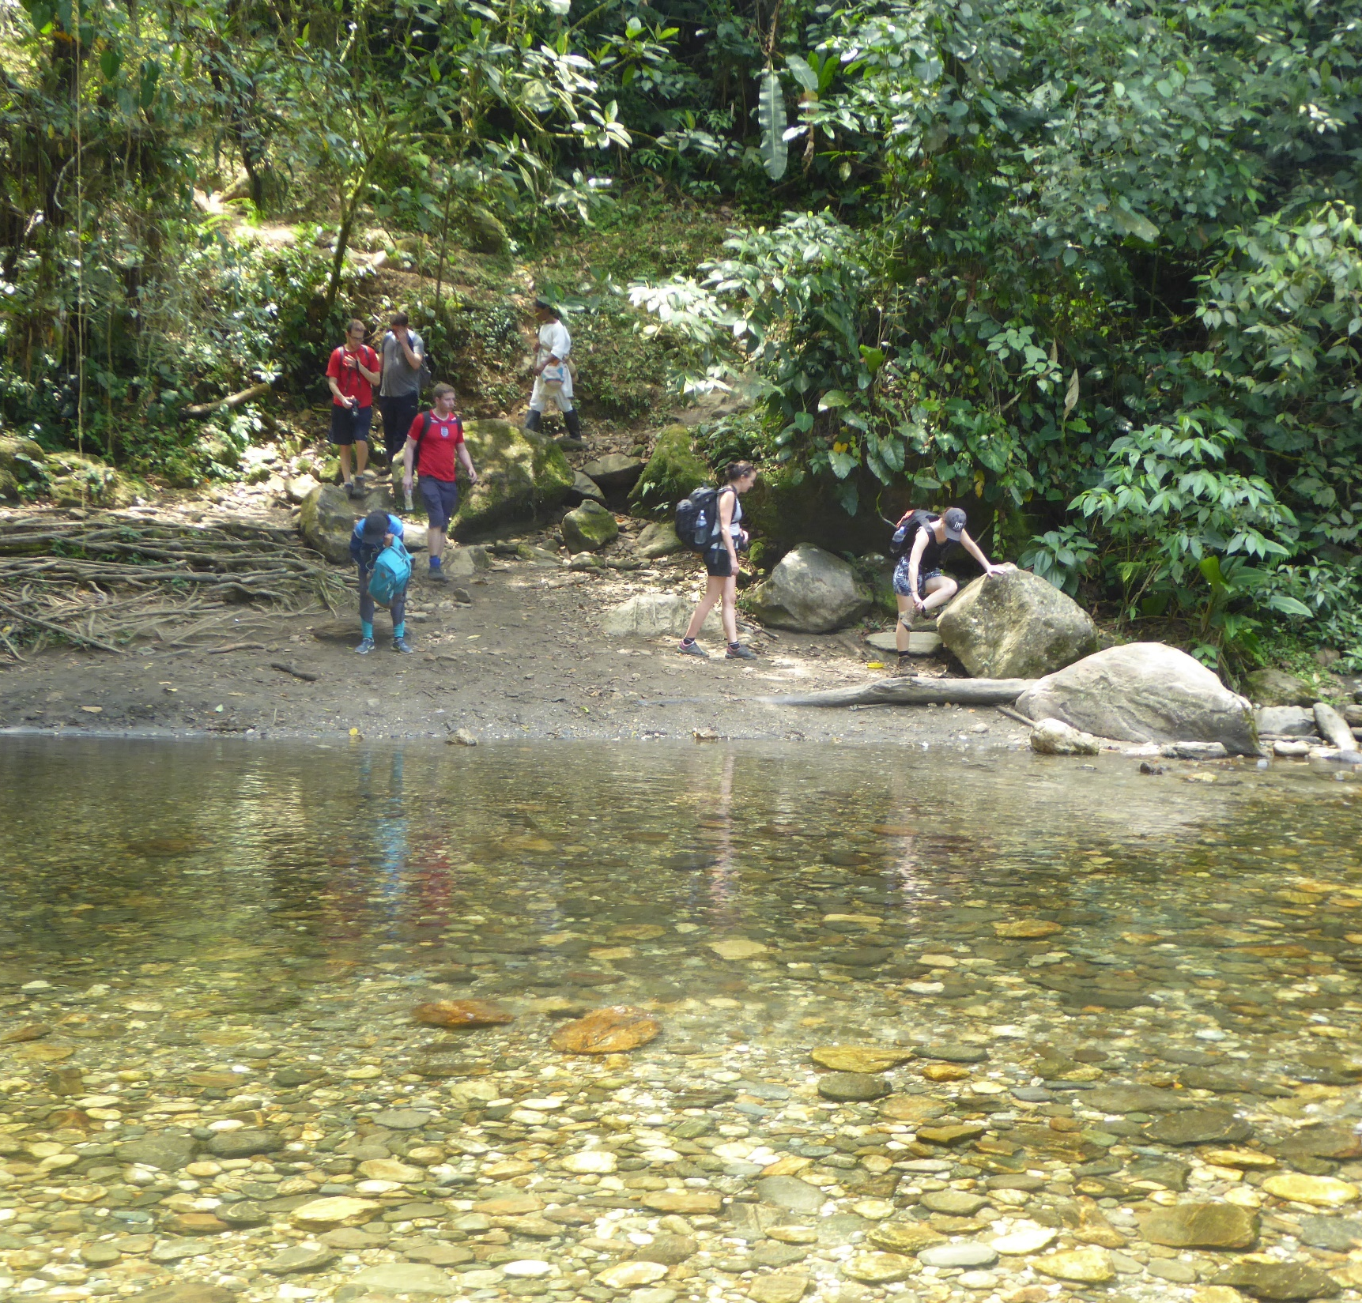

Slide 16
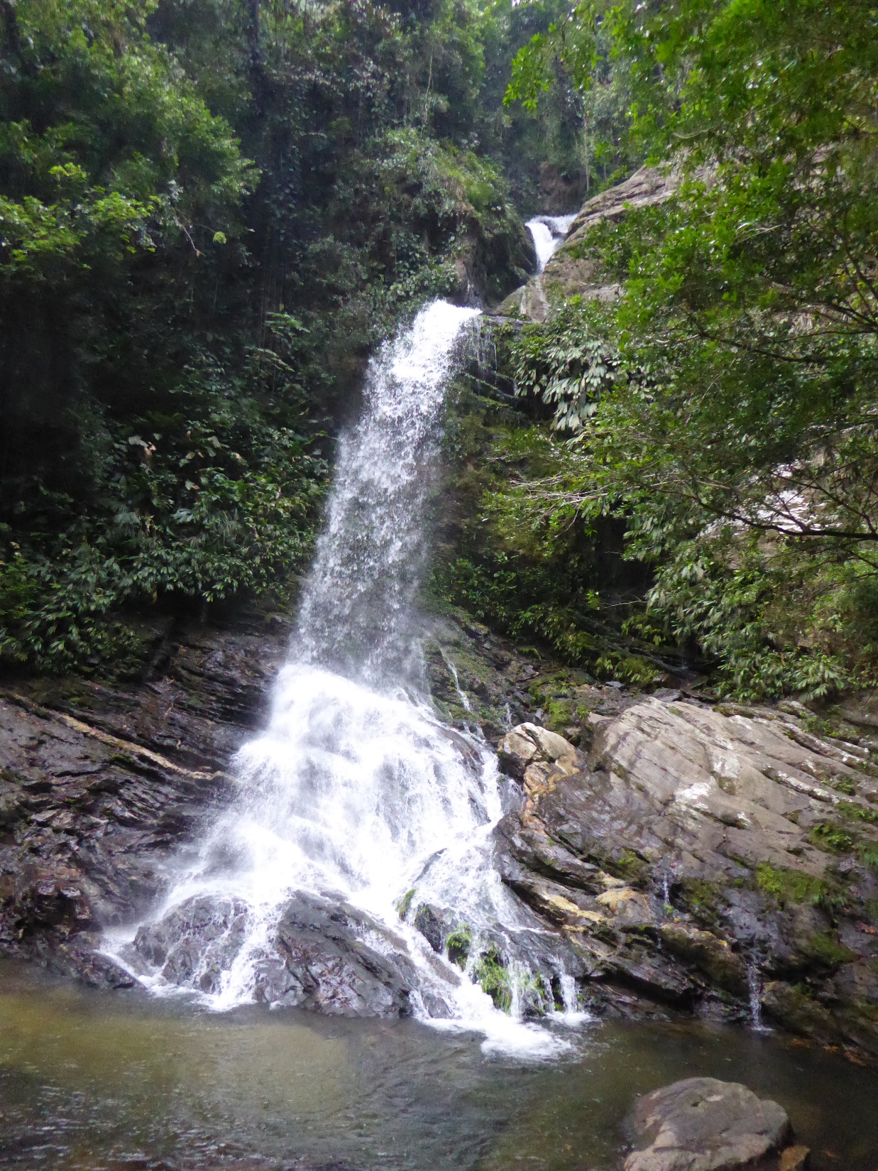
Day 6: Wiwa Camp – El Mamey – Santa Marta
Our final day in the jungle sees us returning back to the trailhead at El Mamey, stopping en-route at a waterfall where we can cool off.
We meet the 4 x 4 vehicles and drive back to the road, and on to Santa Marta, where a well-earned bed and shower await!
There should be some time free to enjoy wandering the sights of Santa Marta.
Trek: 5.5-7 hours
Drive: approx. 2 hours
Night: Night hotel. (Dinner not included)

Slide 17
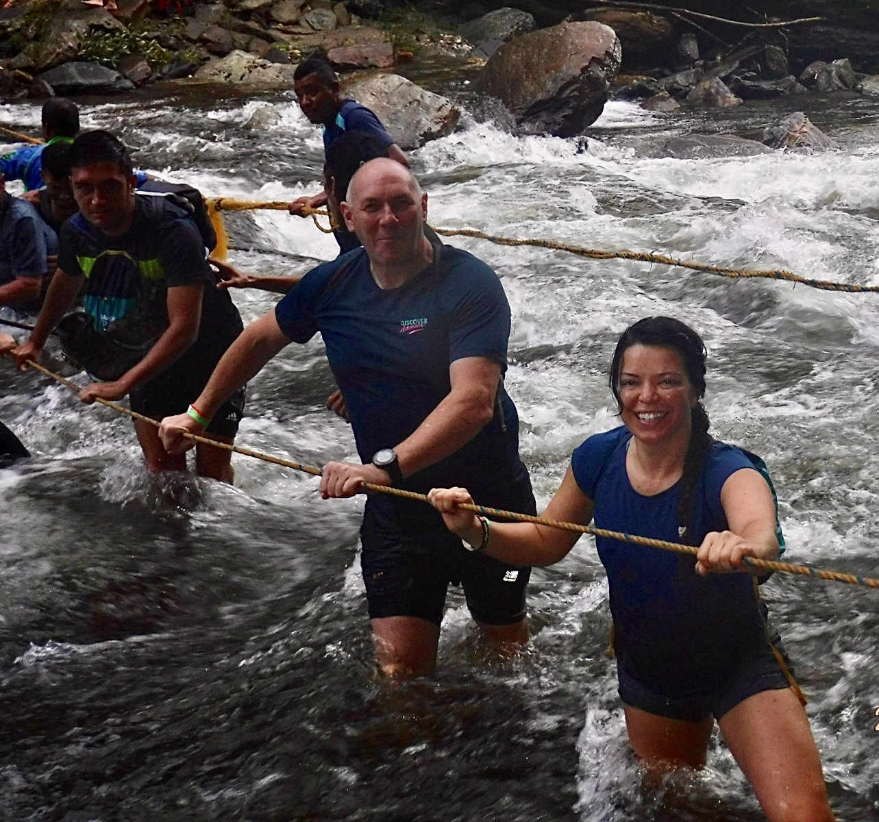
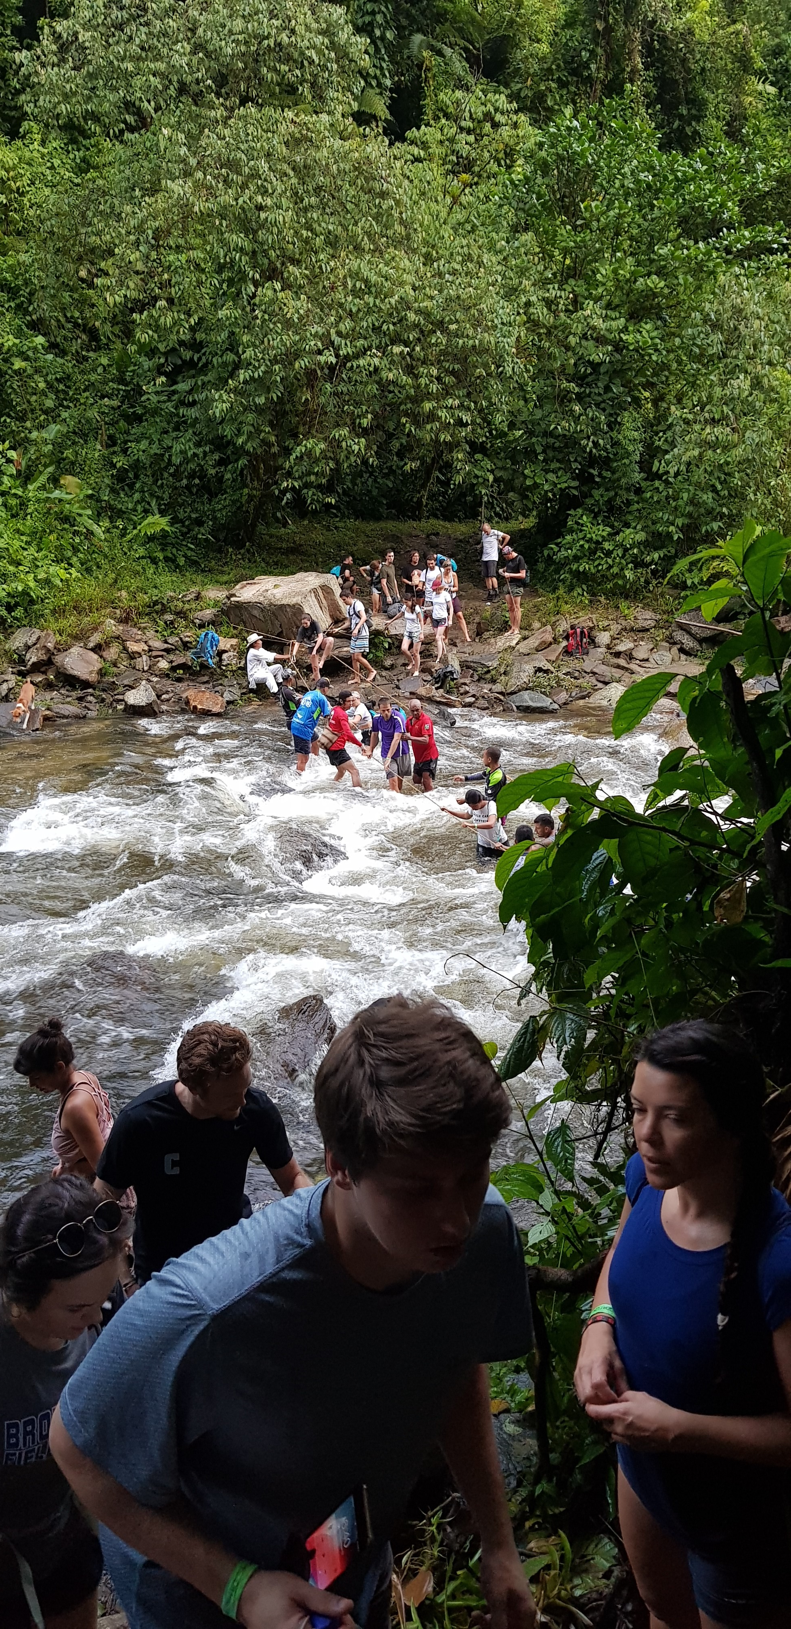
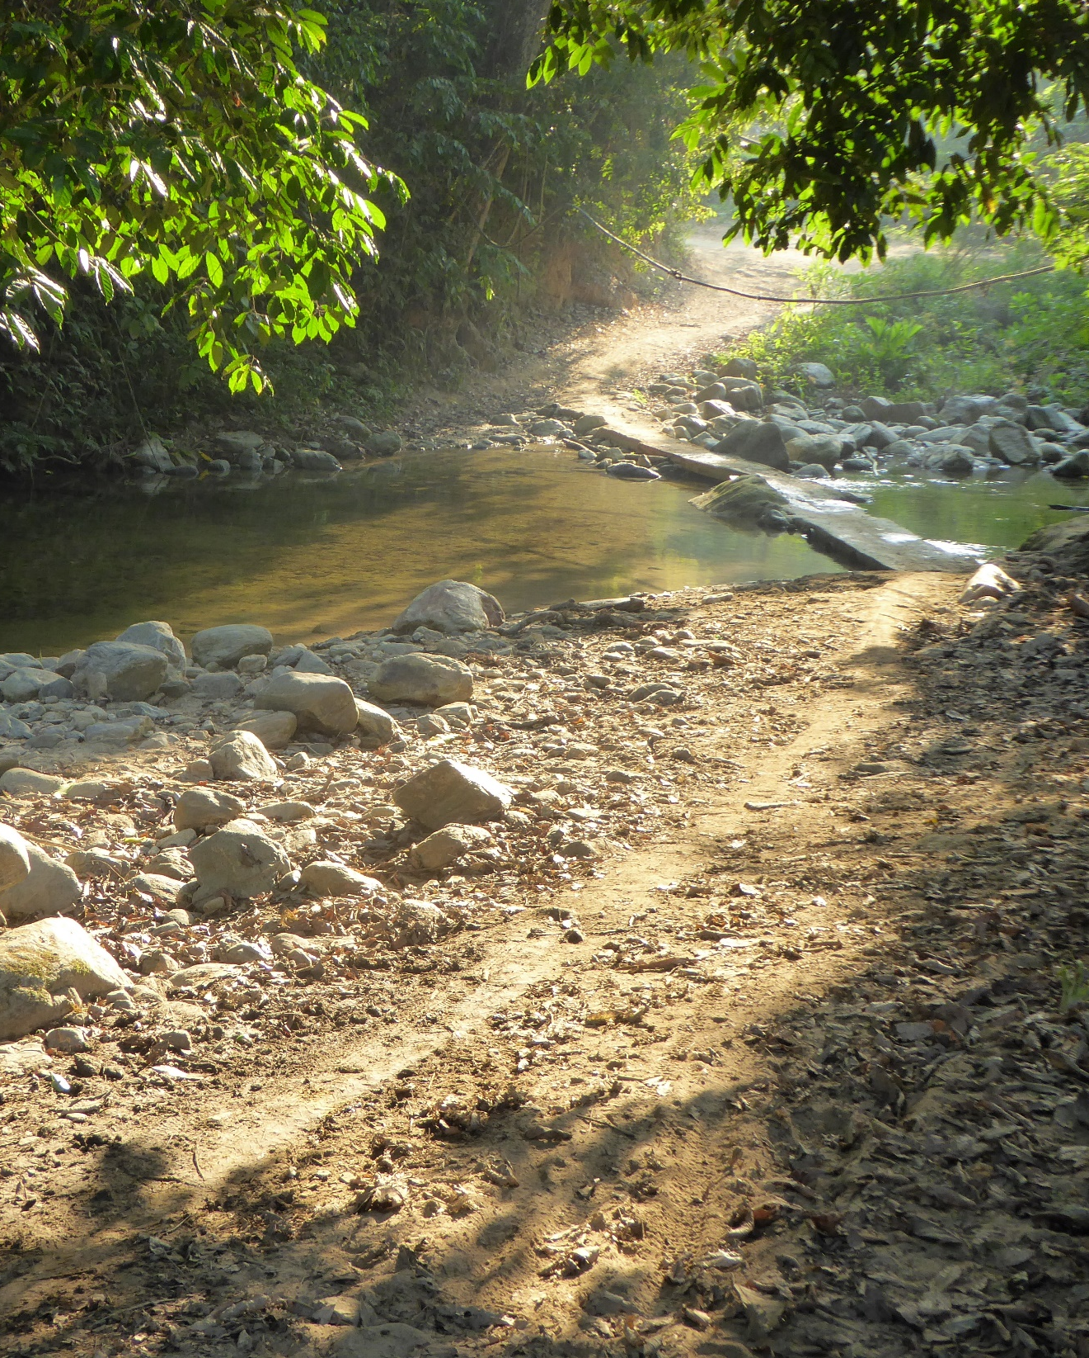

Slide 18
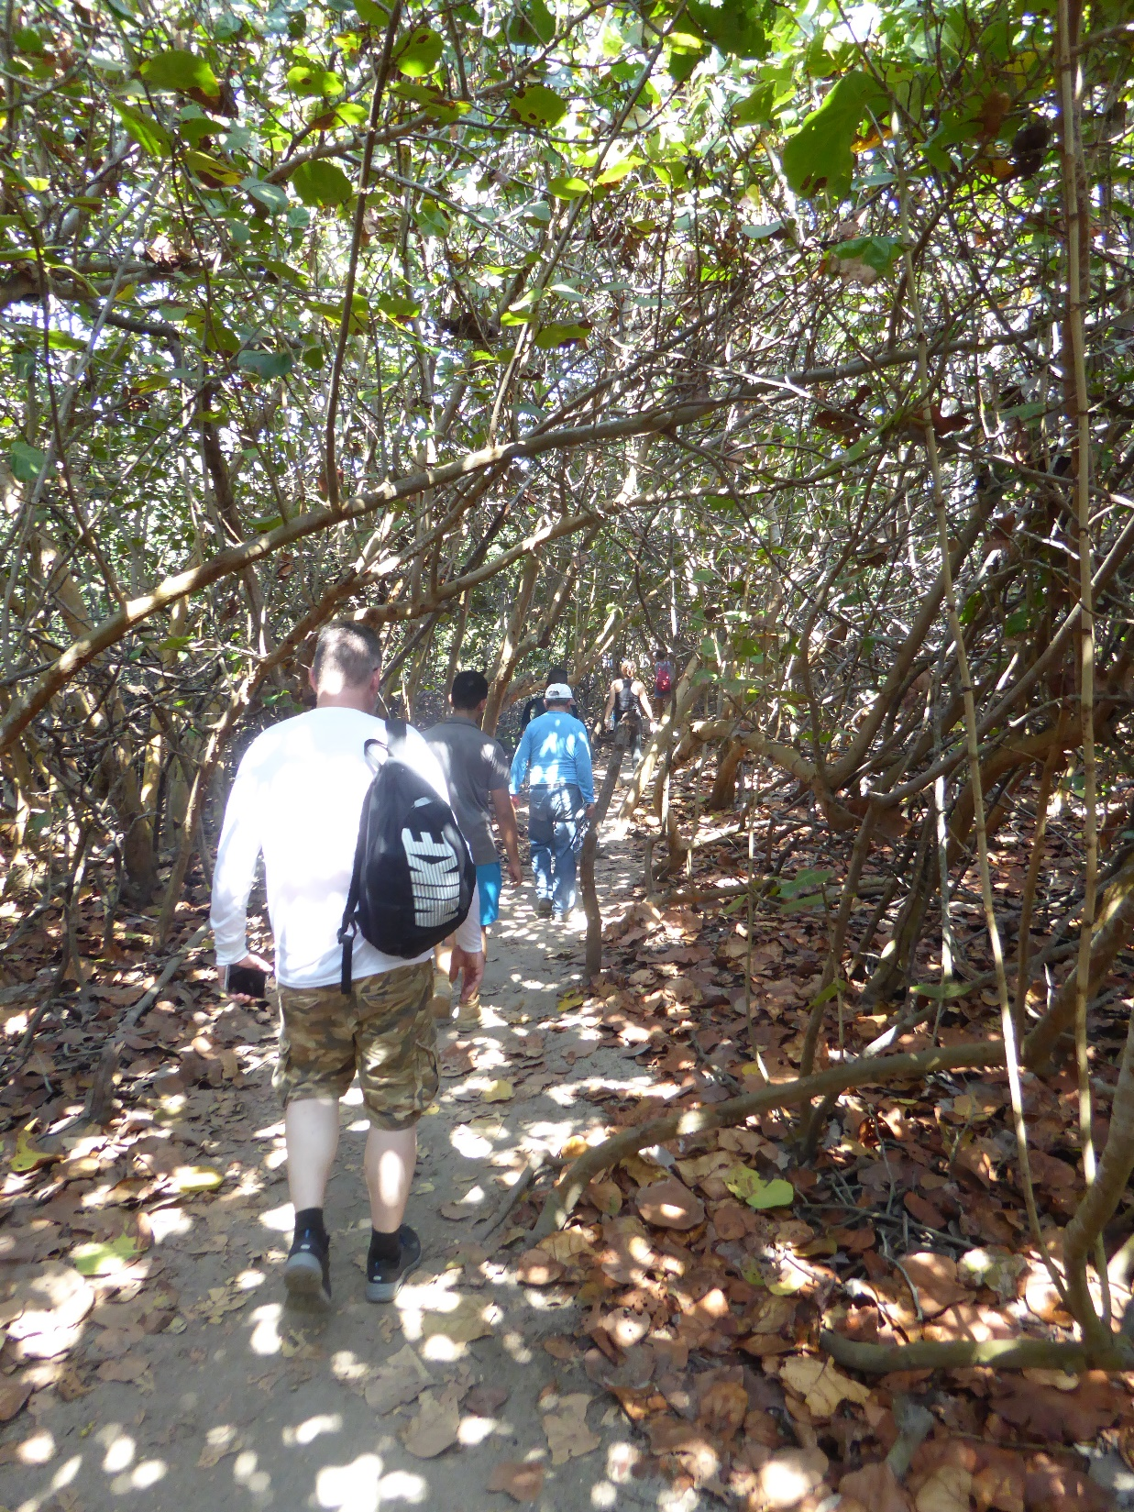
Day 7: Santa Marta – Tayrona National Park – Santa Marta
A hike with a difference today, as we explore beautiful Tayrona National Park, where the rainforest meets the Caribbean.
Huge granite boulders and small coves protected by the coral reefs. We explore the old trails at a relaxed pace,before enjoying a swim in the natural swimming-holes.
The coastal beauty contrasts hugely with the more arduous rainforest habitat we have been immersed in.
We return to Santa Marta.
Trek: approx. 4 hours
Night: hotel

Slide 19
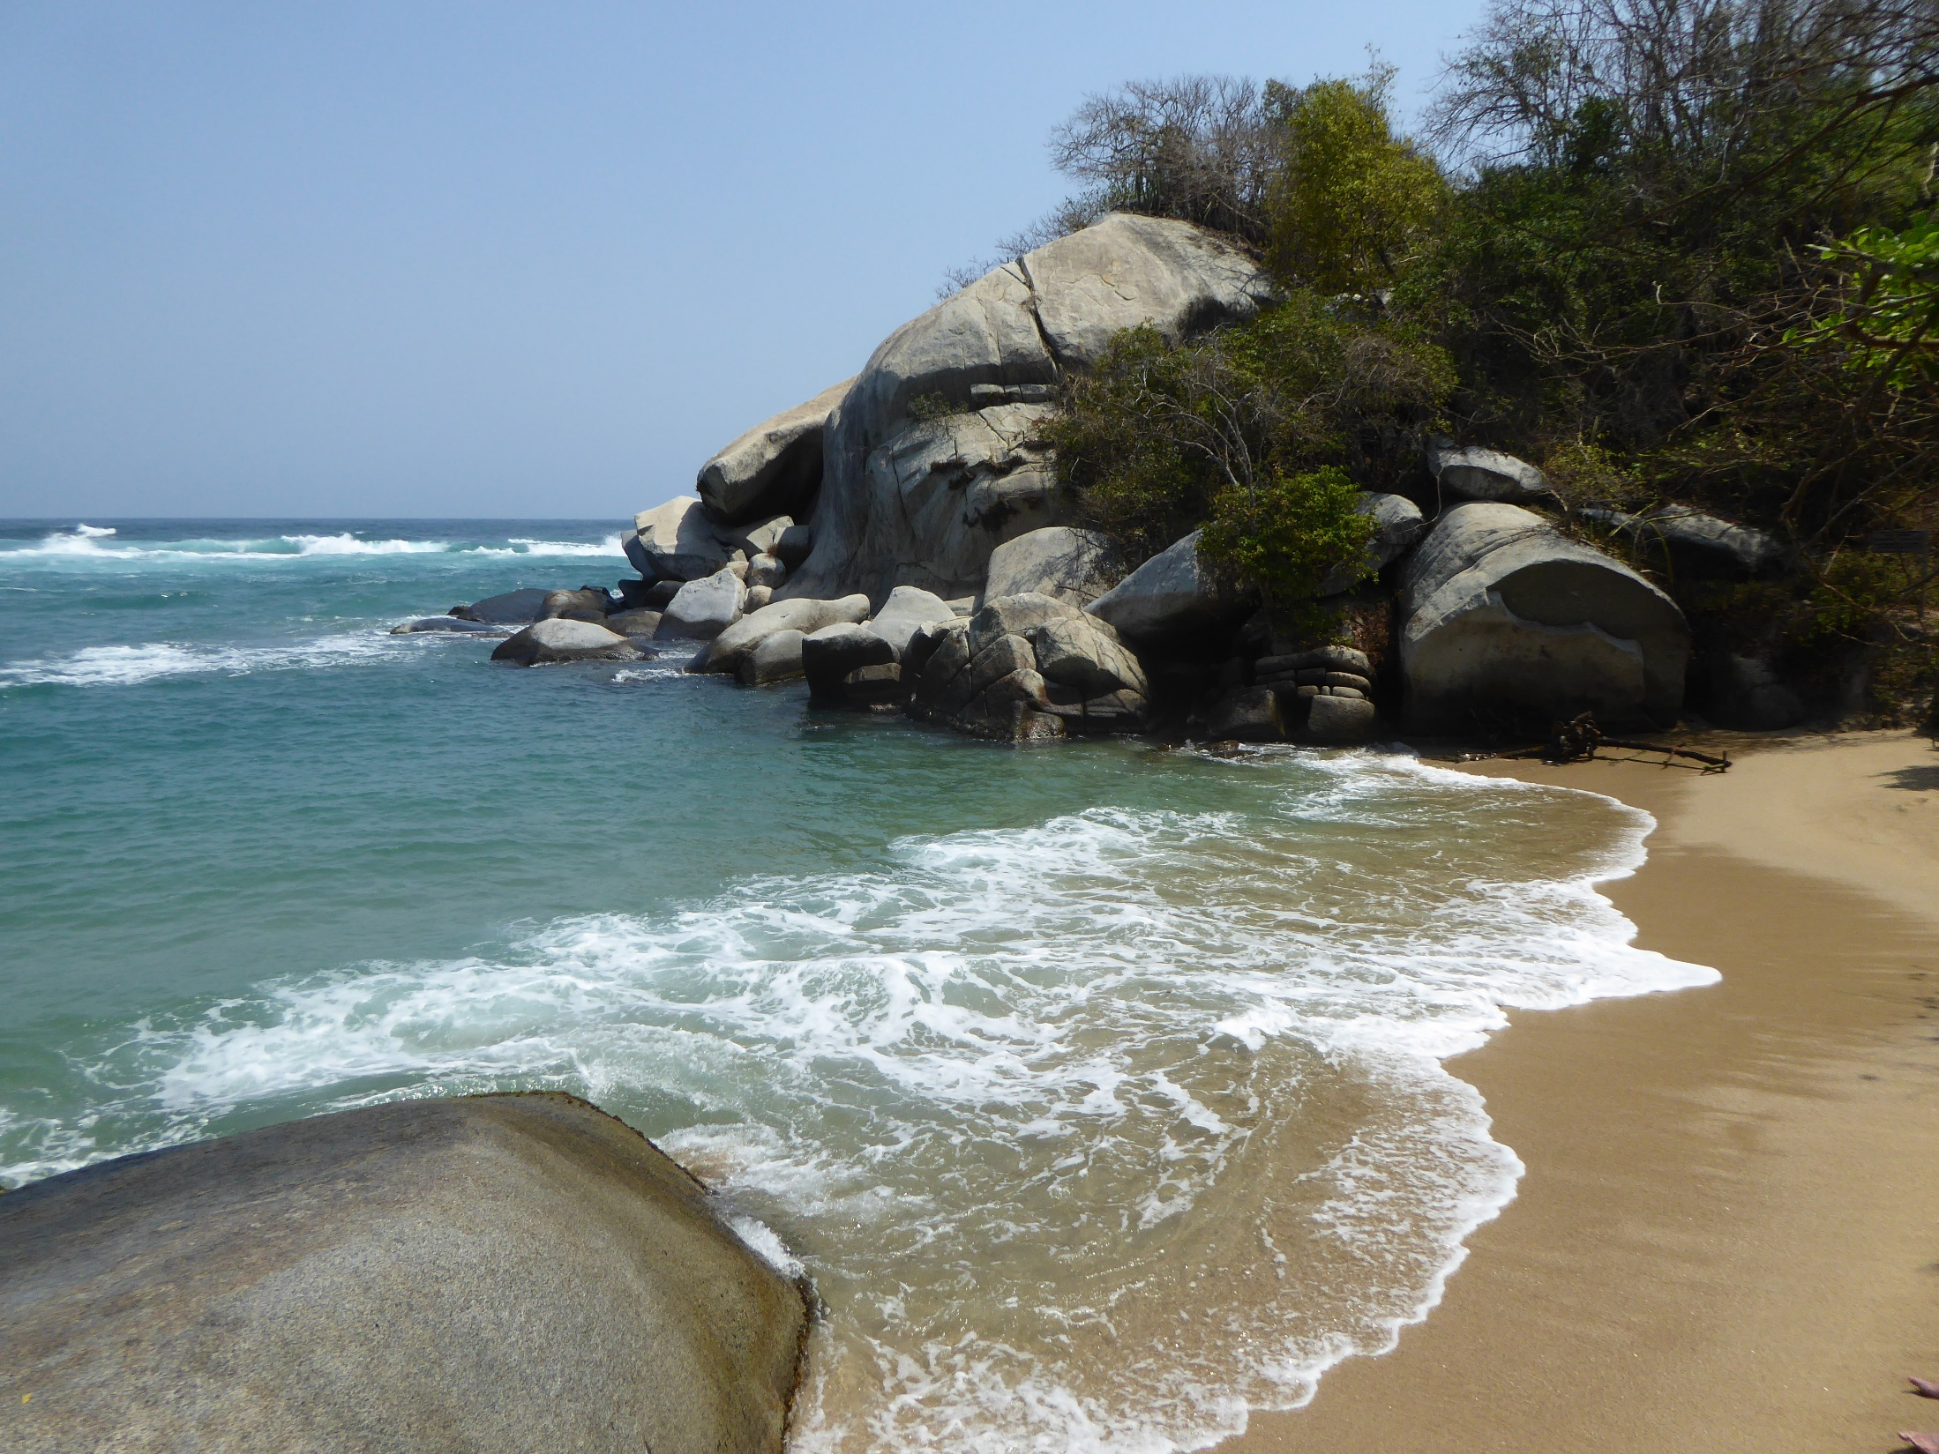
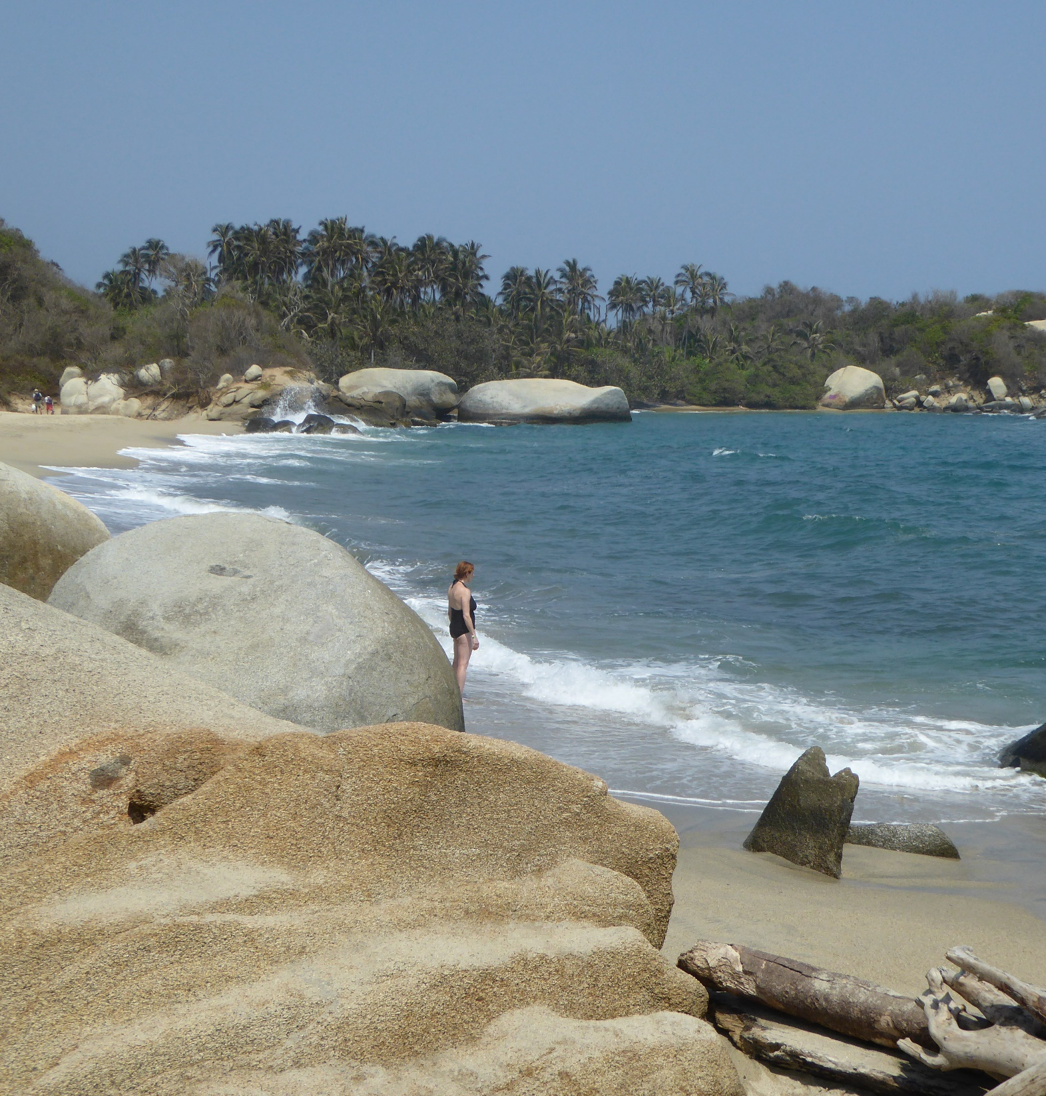

Slide 20
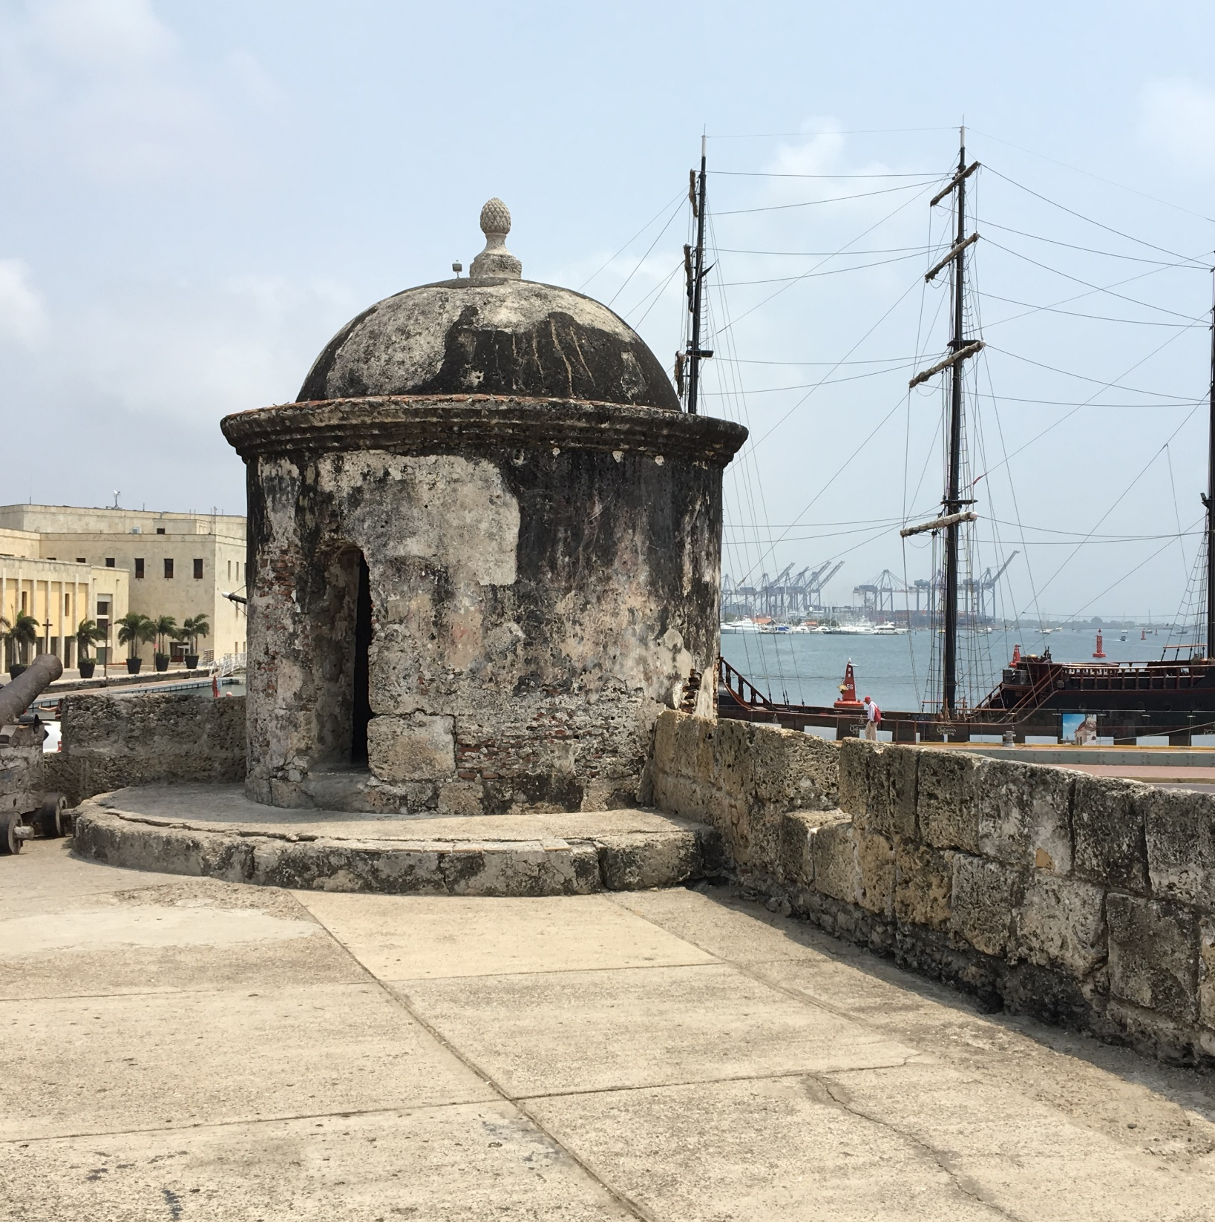
Day 8: Santa Marta – Cartagena
Transfer to the colonial city of Cartagena an important town and port for the Spanish colonies.
The walled city and San Felipe fortress have UNESCO World Heritage Site status.
After a city tour of the main historical sites we have plenty of time to relax, wander and shop the markets.
Drive: approx. 5 hours (inc stop for lunch)
Night: hotel

Slide 21
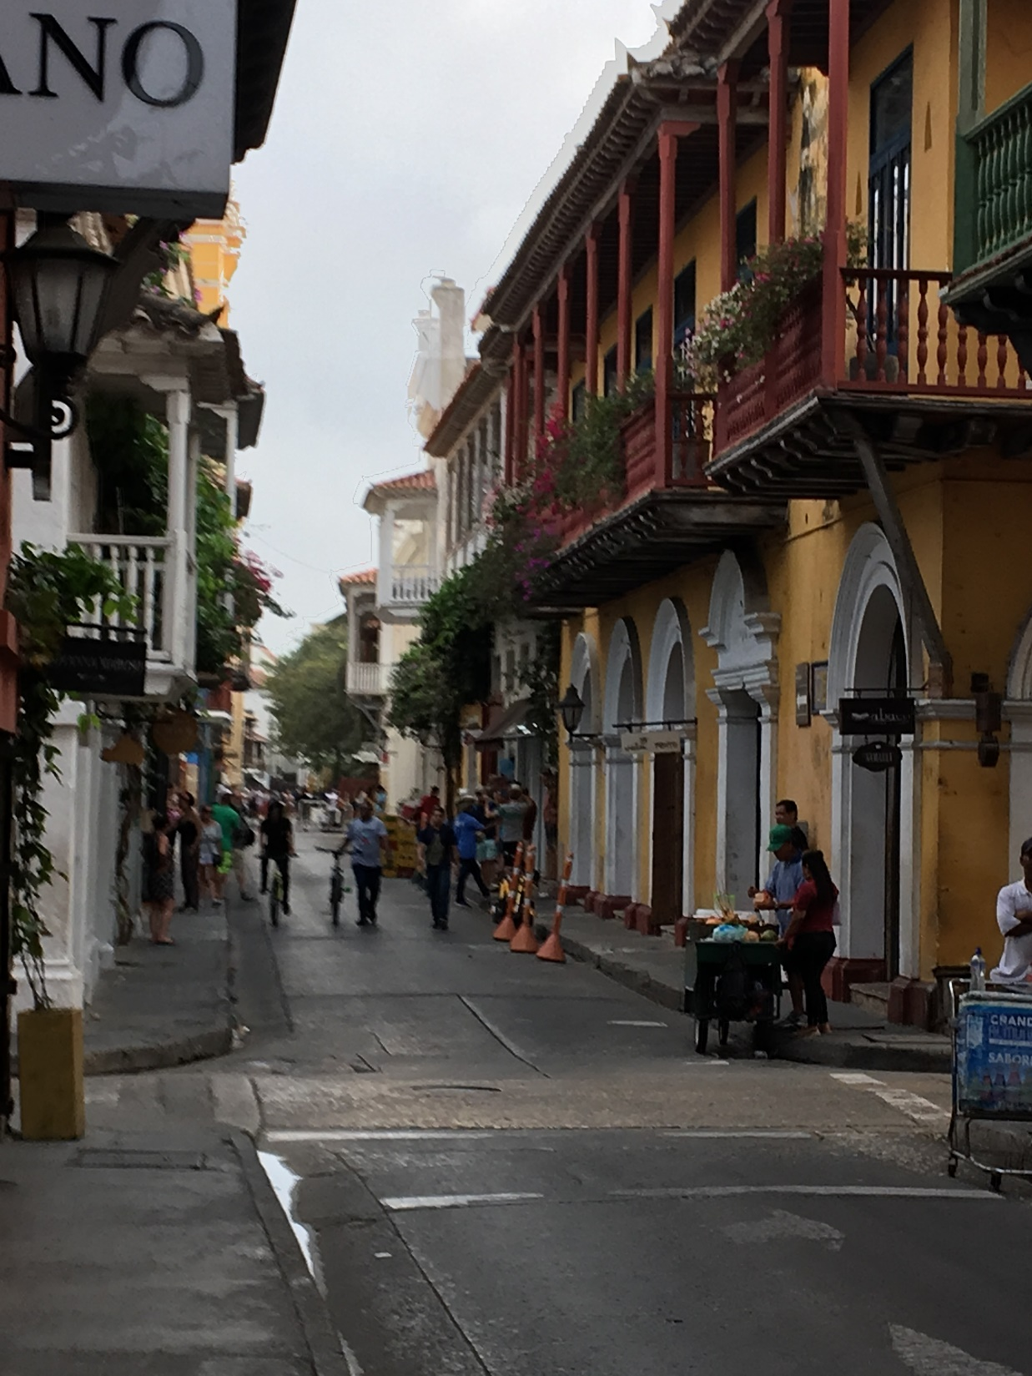
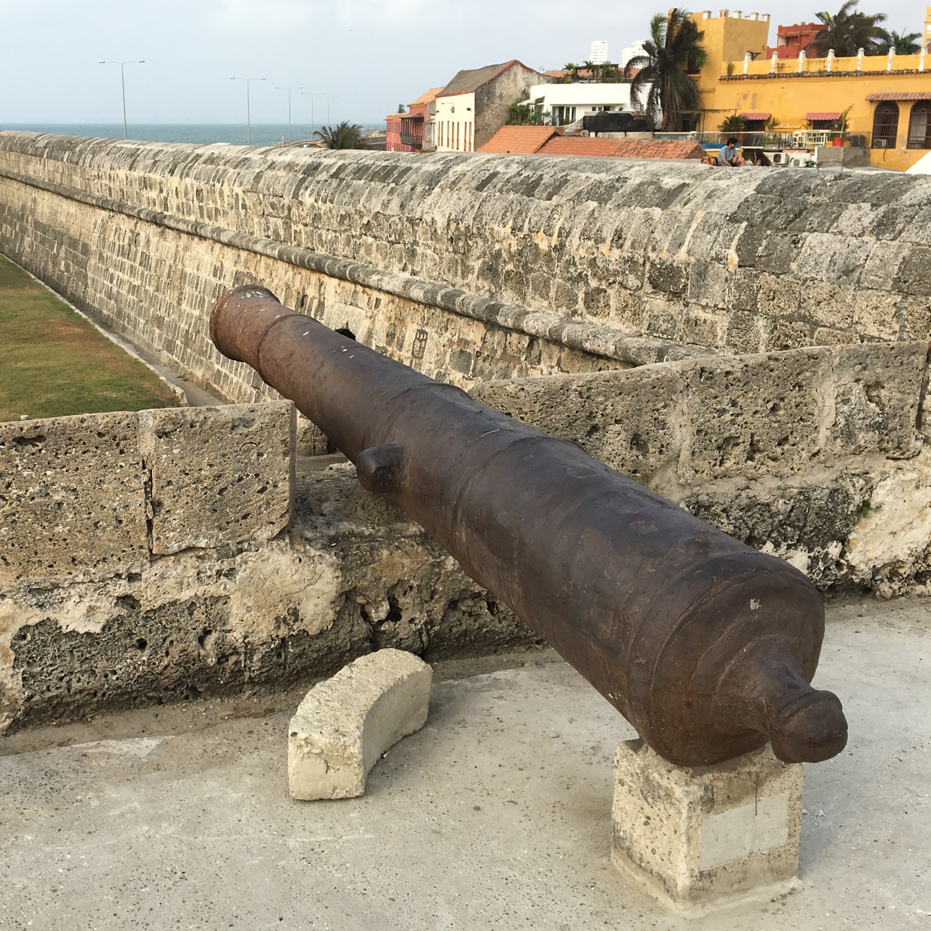

Slide 22
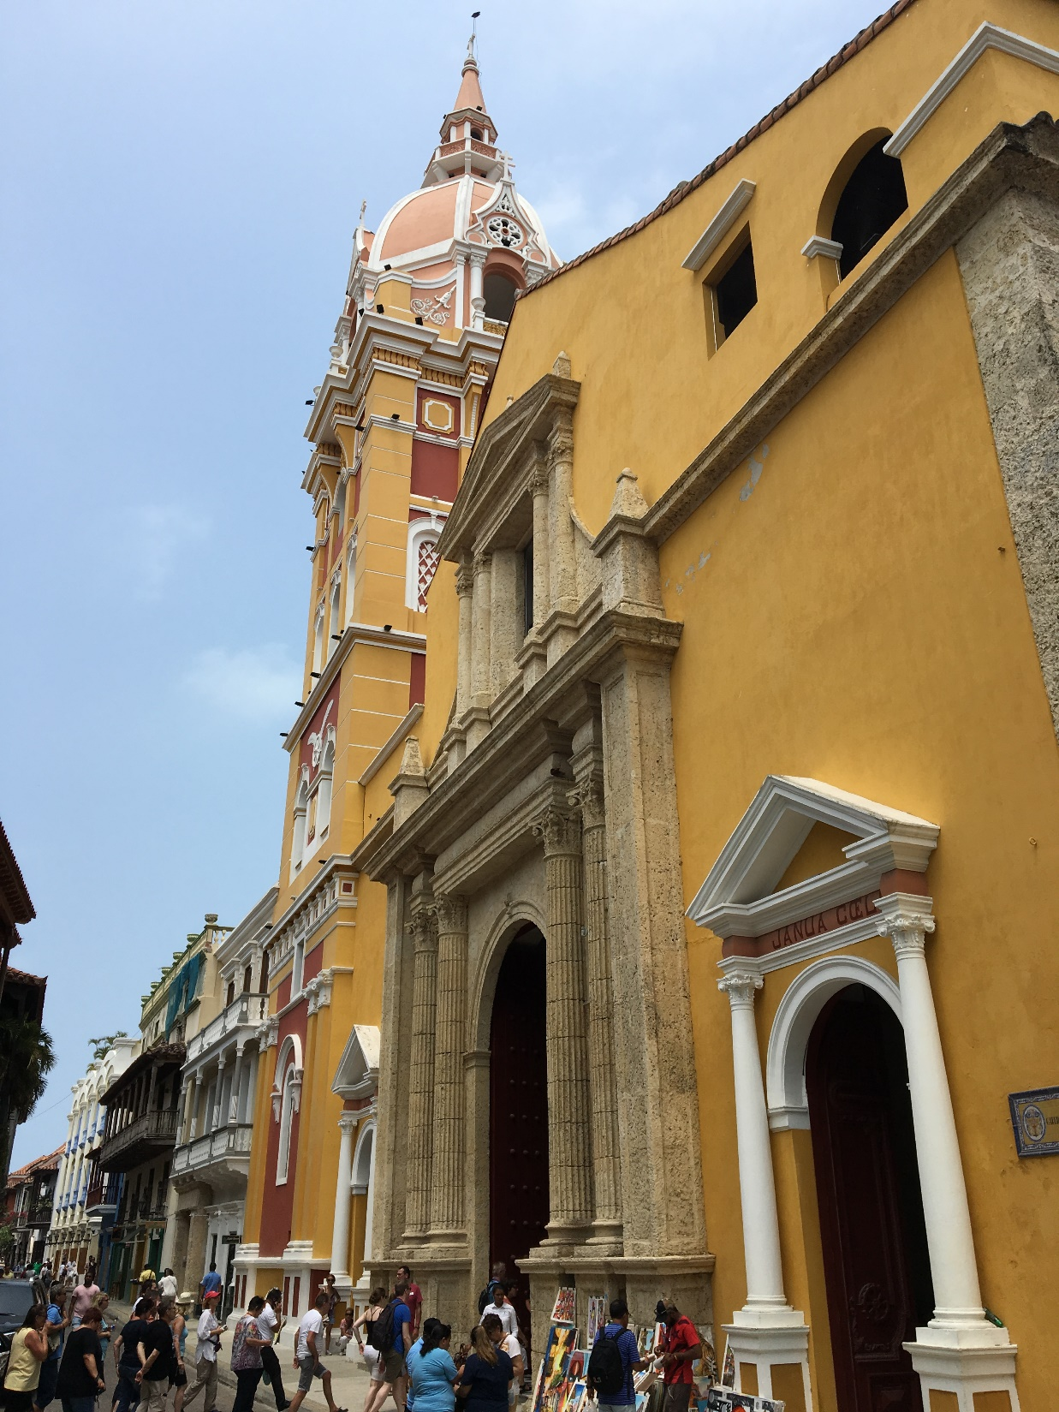
Day 9: Cartagena; Flight departs
Free time to enjoy discovering more of the charm of Cartagena, before transferring to the airport for our flight home
(Lunch and dinner not included)

Slide 23
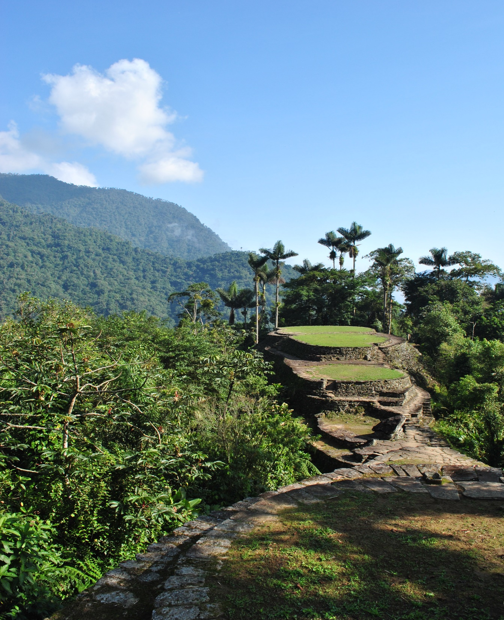
Day 10: Arrive London
Arrive at Heathrow airport.

Slide 24
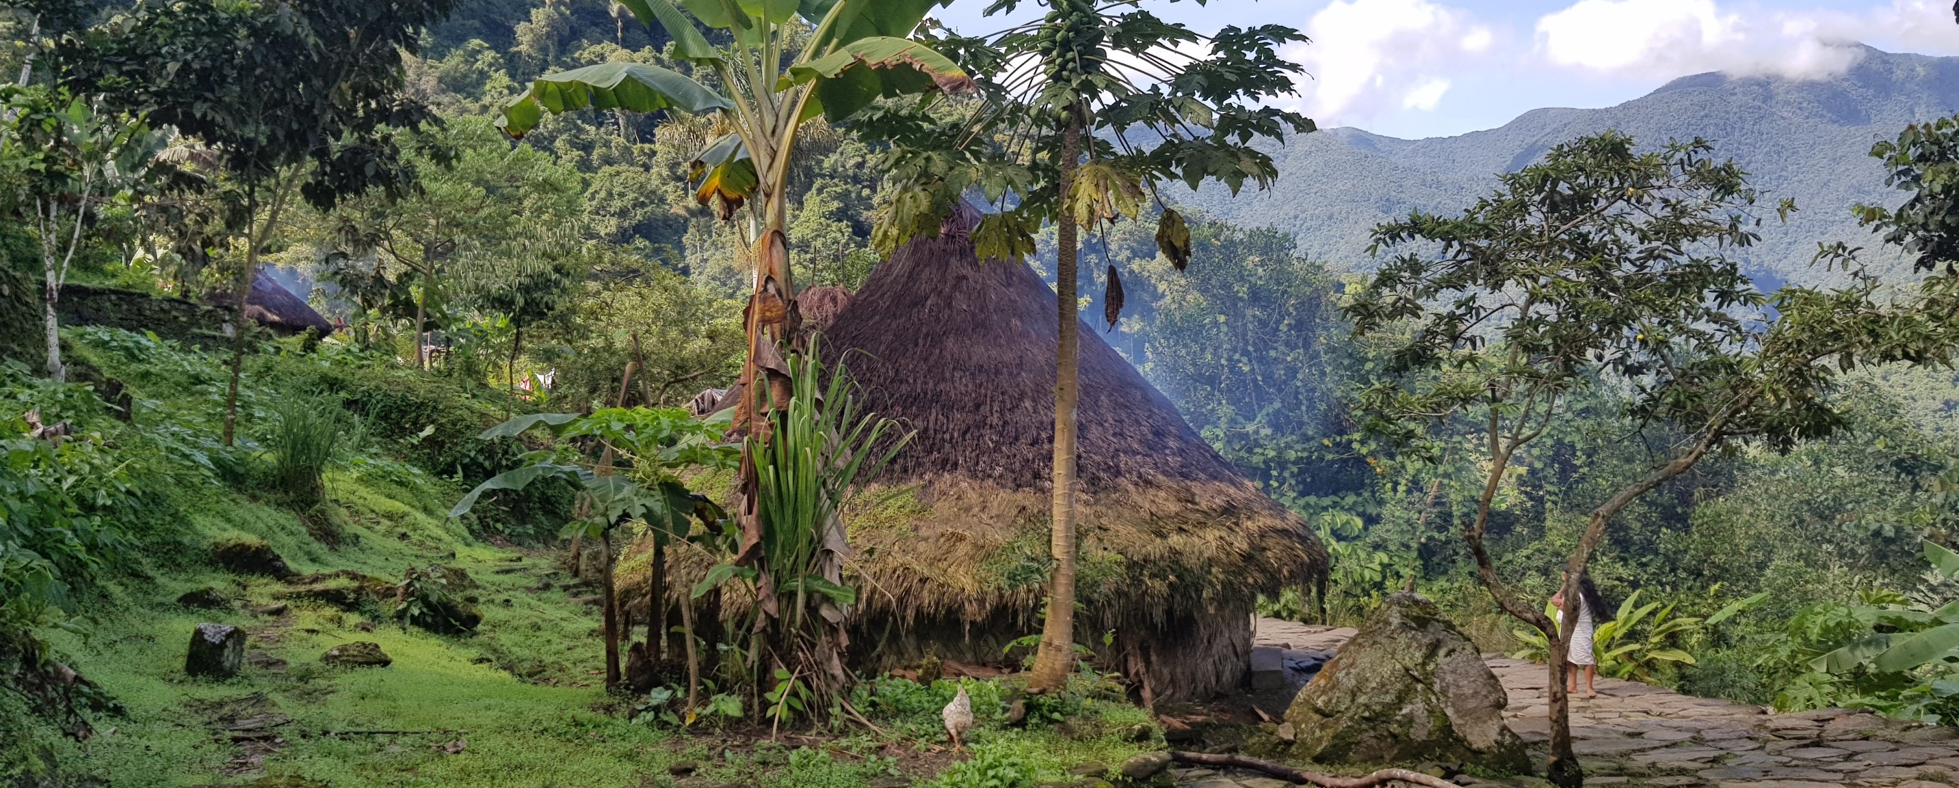
ANY QUESTIONS?
01722 718444
www.discoveradventure.com

